Slide 1




Terror Behind the Walls:
A Spooky Collaboration
Adaptive Memory Lab
Social and Affective Neuroscience Lab
SAN

Slide 2





Project Introduction
Rationale
Methods
Measures
How does emotional and physiological arousal inform perceptions?
How does arousal affect memory contiguity at recall?
When does emotion predict regulation?
How do emotion and arousal affect what you remember?

Slide 3

Why collaborate?
The friendships
Also,
Lab-based studies provide valuable insights to behavioral and cognitive processes
However, the generalizations of such findings may be limited
In real-world settings, a range of emotionally rich stimuli may elicit a variety of spontaneous responses (e.g., self-regulation, physiological effects) that contribute to how experiences are encoded and recalled
SAN
Notes:
To both lab’s benefit to do a naturalistic paradigm

Slide 4

Terror Behind the Walls Fills the Gap
Naturalistic, but controlled environment
Performances are reliably consistent
Appropriate stimuli variability
Better approximates intense feelings

Slide 5






Adaptive Memory Lab at Temple University
Low arousal context, with different hallways/rooms
Controlled, less immersive experience
Low stimuli variability (audio, visual, tactile, olfactory)
Often similar environments used in past research!

Slide 6

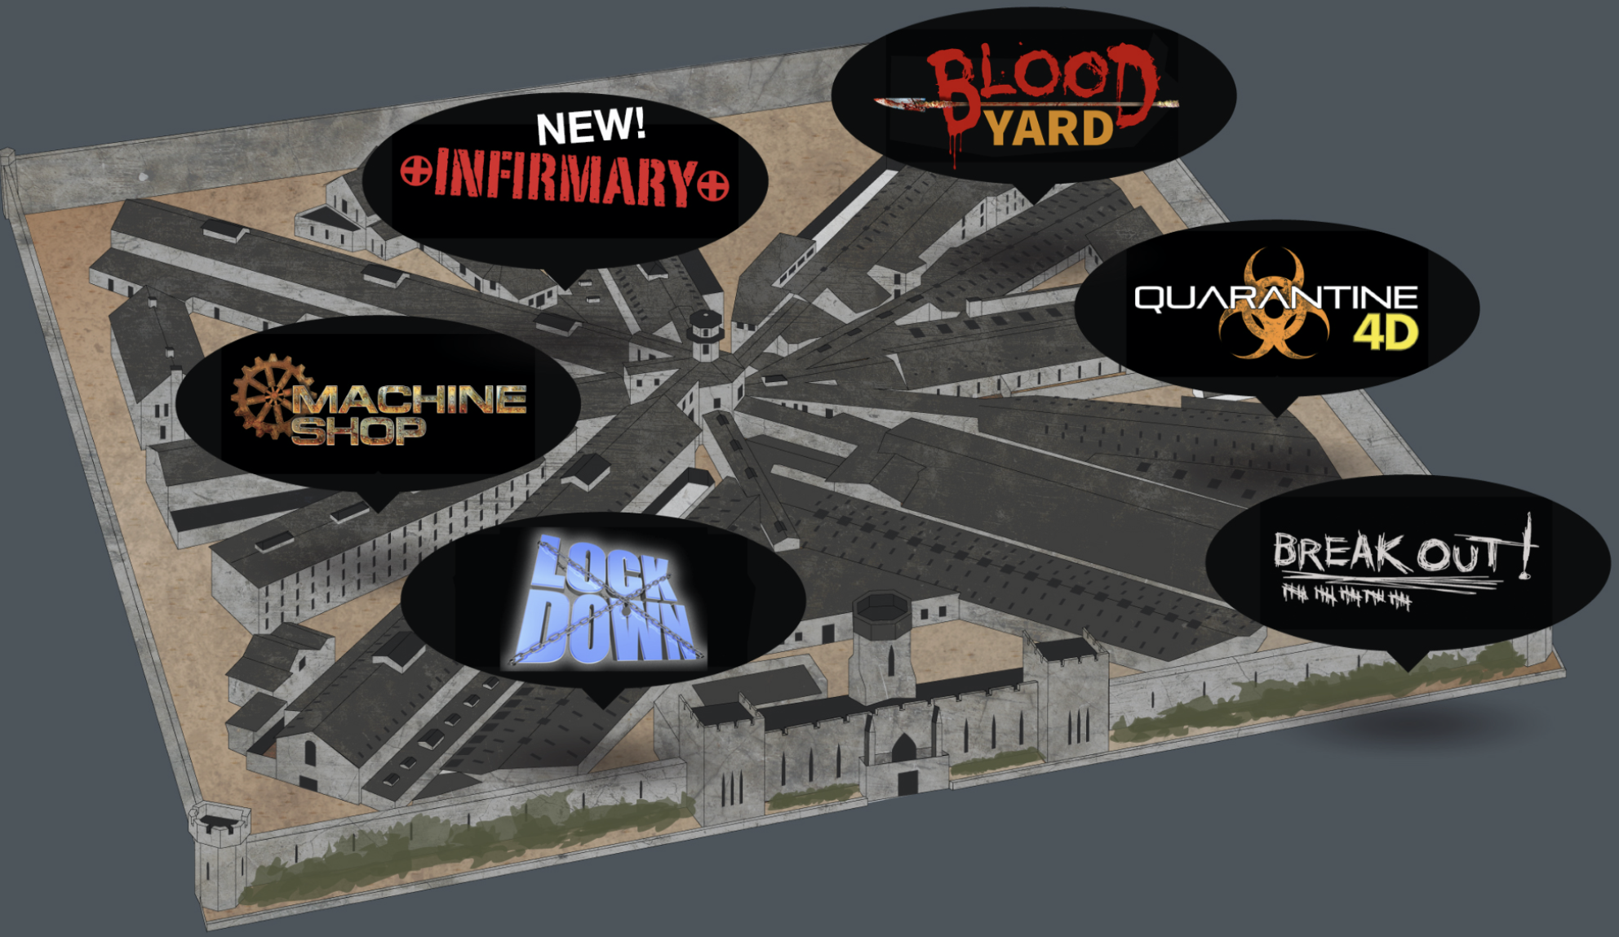







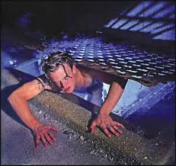
4
3
5
TRIGGER!
2
High arousal context, 6 distinct segments
Controlled, naturalistic immersive experience
High stimuli variability (audio, visual, tactile, olfactory)
Unique environment to run psychological studies!
6
1
1
2
3
4
5
6

Slide 7
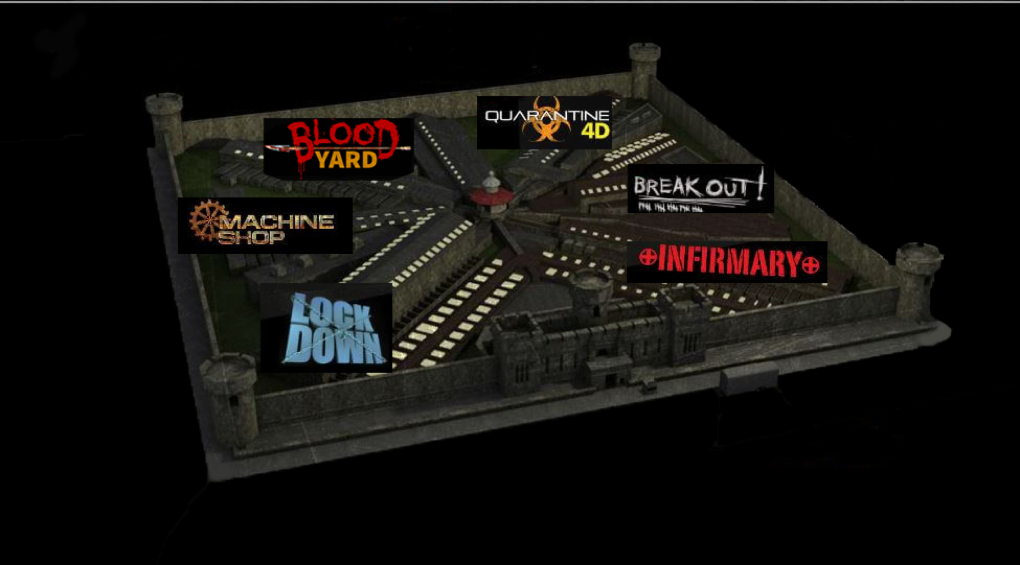

TRIGGER

Slide 8
Methods
54 participants (26F, M_{age}= 24.22, SD_{age}=3.97) arrived at Weiss Hall
15 groups of 3-5 participants
Fitted with heart rate monitors and audio recorders
Baseline HR recordings were taken while questionnaires were filled out
Participants and two RAs traveled to Eastern State Penitentiary to experience Terror Behind the Walls
Participants answered one question after each of the six discrete sections
“How scary was that last section for you, on a scale of 1(Not scary at all) to 5 (Extremely scary)?”
5-7 days later participants returned to Weiss Hall for a follow-up session
Participants completed a surprise free-recall task undergoing an fMRI scan
Participants completed questionnaires about their experience at the haunted house

Slide 9

Overview of Data and Measures Collected
Prior to Haunted House:
Pre-Haunted House Questionnaire
During Haunted House:
Heart Rate Measures
Fear Ratings of Sections
During Follow-up Session:
Free Recall Memory
fMRI
Post-Haunted House Questionnaires

Slide 10
Project Introduction
Rationale
Methods
Measures
When does emotion predict regulation?

Slide 11

Billy Mitchell
Regulation Raconteur
Question:
When does emotion predict regulation?
Measures Used:
From Follow-up Session:
Post-Exposure Questionnaires

Slide 12
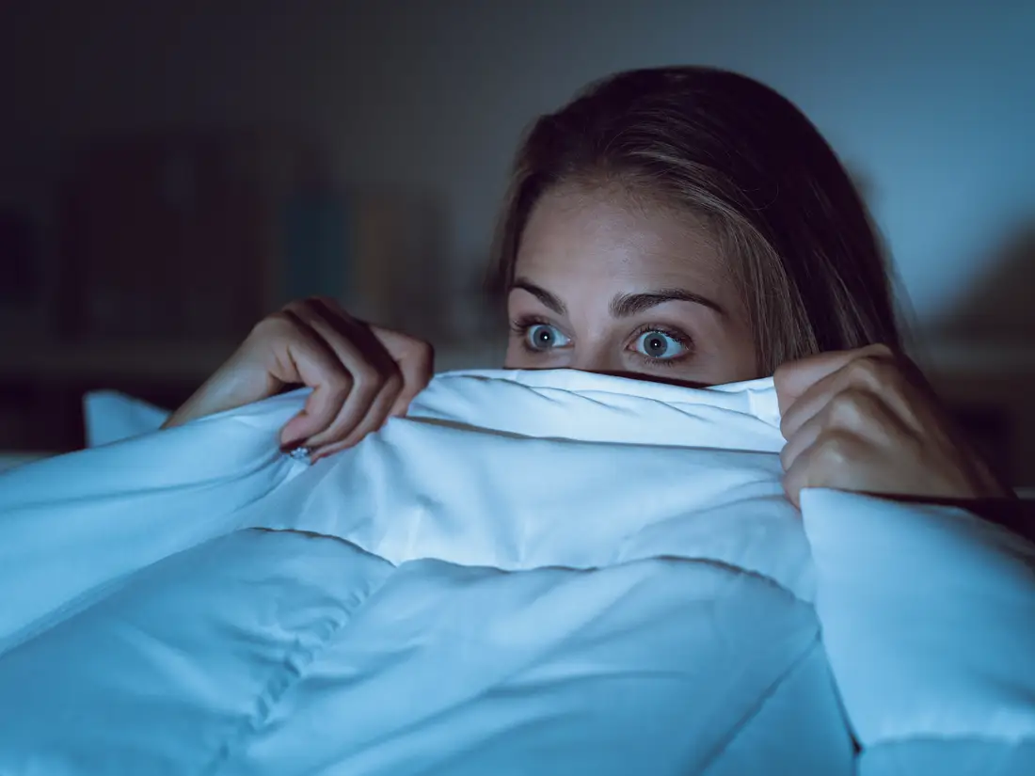

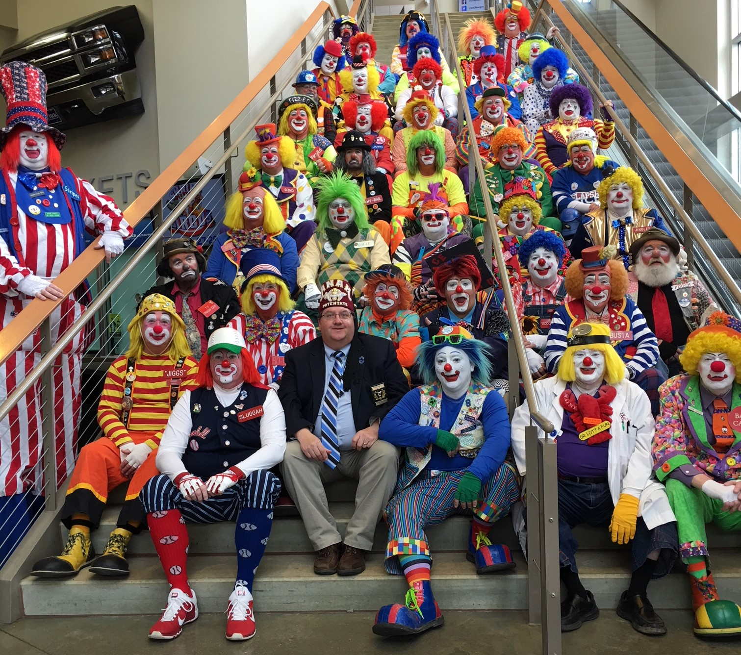
When We Regulate At Eastern State: Emotion Regulation Beyond the Lab
Definition:
The processes by which we influence which emotions we have,
when we have them, and how we experience and express them.¹
Examples:
“They’re just actors; they won’t really hurt me.”
“I’ll just stare at my shoes while I walk through this”
“I’m not scared. I’m not scared. I’m not scared …”
¹Gross, 1998
Notes:
This dataset allowed me to explore factors that influence the relationship between emotion and how we regulate it. We often define emotion regulation as the processes by which we influence which emotions we have, when we have them, and how we experience and express them, which I think is pretty accessible. Like You can probably remember a time when you were home alone in your living room watching Nightmare on Elm Street and you had to remind yourself it’s just a movie, or when you felt anxious because everyone’s attention was suddenly focused on you, or when you happen to come across three dozen clowns sitting on a staircase. In all of these situations, we’re likely to take some cognitive or behavioral action to downregulate our fears and anxieties. If we fail at regulating our emotions in these examples, we’re probably only risking comfort. Maybe you have a nightmare or an awkward experience,

Slide 13
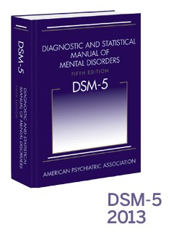


¹ Gross, 1998
² Morawetz et al., 2019
³ Hefner et al., 2016
⁴ Carpenter & Trull, 2013
⁵ Eftekhari et al., 2009
⁶ Seligowski et al., 2015
⁷ McLean & Foa, 2017
How We Regulate At Eastern State: Emotion Regulation Beyond the Lab
Definition:
The processes by which we influence which emotions we have,
when we have them, and how we experience and express them.¹
Examples:
2,3
4,5
6,7
Notes:
but the stakes are much higher in cases of situational danger and risk-taking, psychopathology, and high-stress traumatic scenarios. Maintaining self-control can be vitally important in these situations.

Slide 14
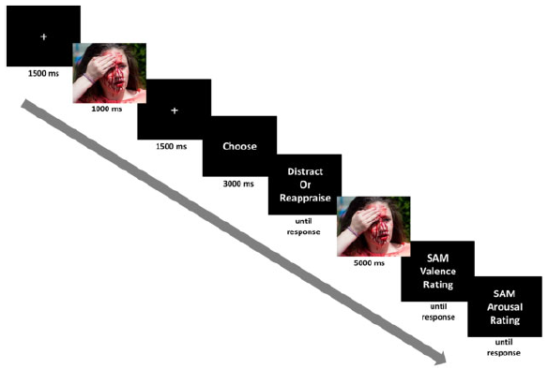
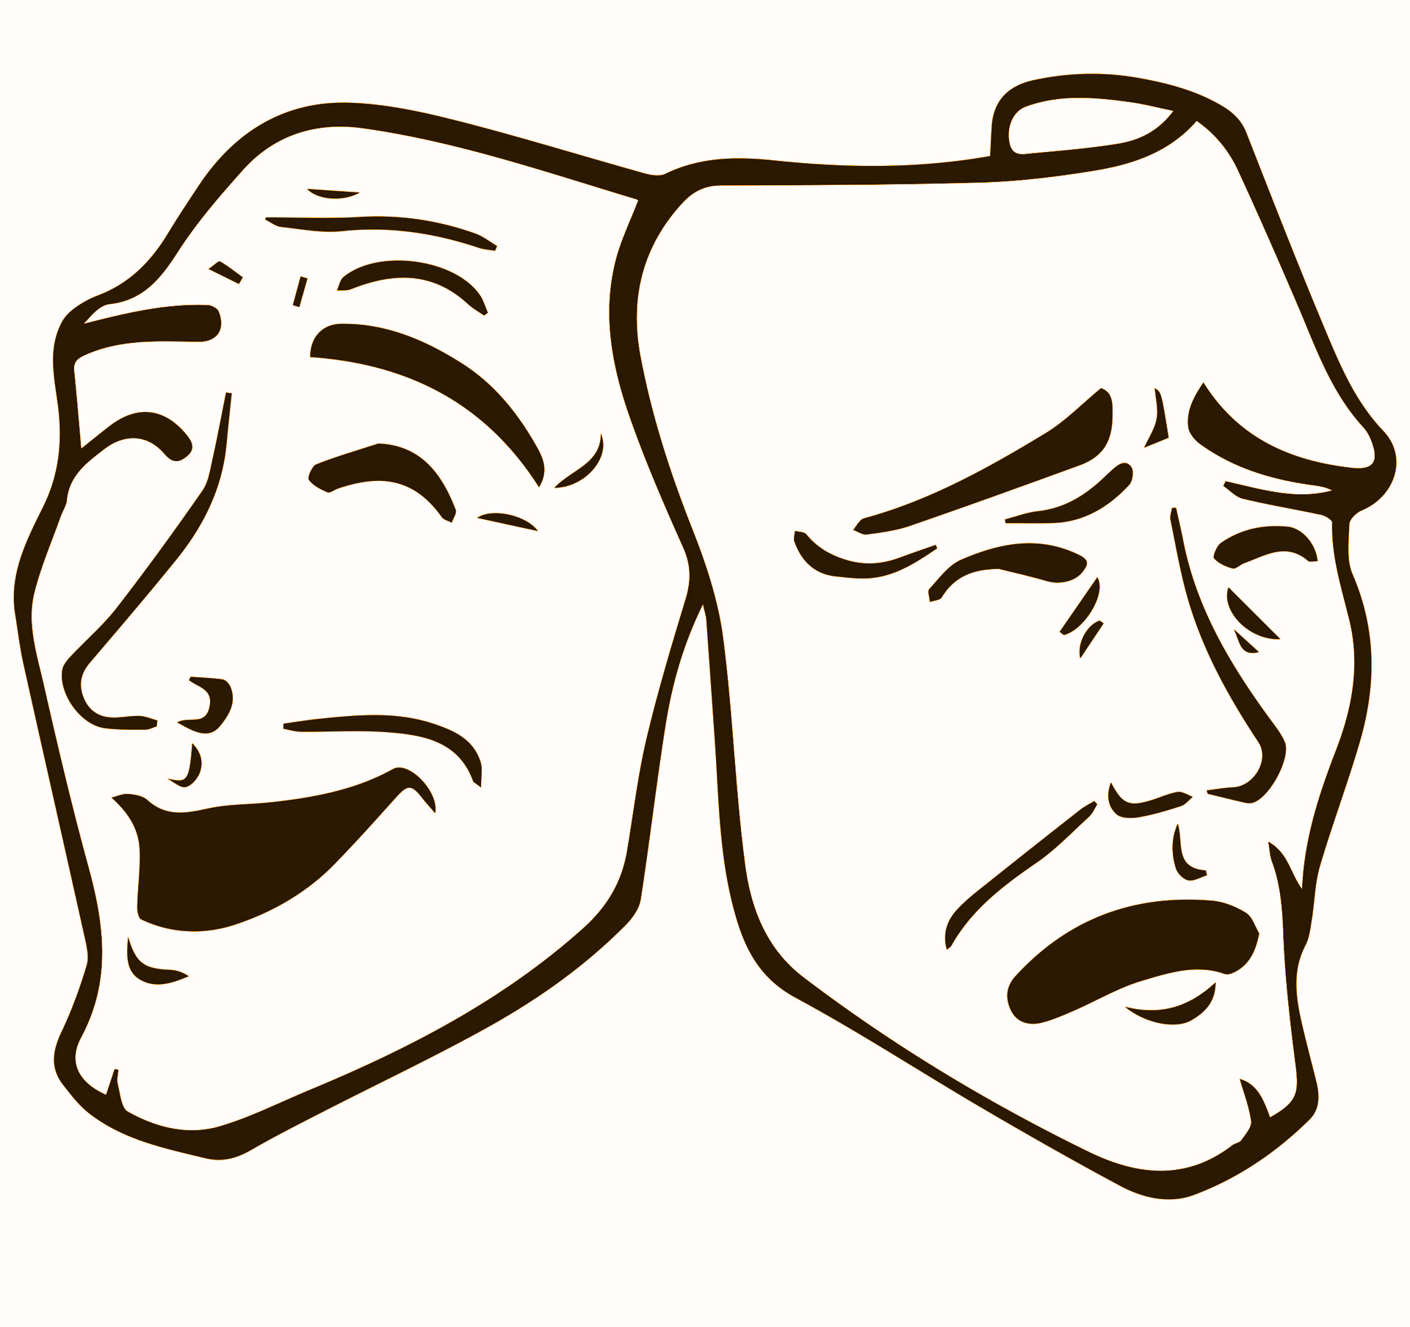
Studying Regulation Thus Far
Lab Studies:
Participants are trained in regulatory strategies and prompted to regulate ⁸⁻¹¹
Most people are strategy naive
Findings may lack external validity
Stimulus
Presentation
Choosing Regulation
Strategy
Testing
Strategy
⁸ Ilan et al., 2019
⁹ Shafir et al., 2016
¹⁰ Sheppes et al., 2011
¹¹ Ochsner et al., 2002
Measuring
Changes
Notes:
And so we try to recreate both high intensity and low intensity scenarios as best we can in labs so that we can study the phenomena in isolation. Especially over the past two decades, we want to better understand what prompts regulation, which strategies work best and when, and how the interaction of personal goals and environment moderate strategy choice and success. A typical study might train participants in strategies, present emotionally evocative photos, prompt participants to use or choose a strategy, and then take measurements of emotional change after the stimulus is presented again. This format has been absolutely invaluable to the field, but outside of a lab, most people aren’t trained in regulation strategies. There’s no one to prompt you to use a strategy when someone cuts you off in traffic. Instagram doesn’t ask how you’re feeling as you scroll through their photos. And very few photos can produce an emotional reaction as intense as lived experiences. All of these inconsistencies between the lab and common life present concerns for external validity.
TRASH:
Tasks may lack internal validity ¹²
Recent meta-analyses also suggest that these tasks may be failing to measure the same phenomena from lab to lab and test to test as well.
These of course include surveys, fMRI scans, other common means of quantification and have been absolutely invaluable to the field, but outside of a lab, most people aren’t trained in regulation strategies.

Slide 15
Studying Regulation Thus Far
Lab Studies:
Participants are trained in regulatory strategies and prompted to regulate ⁸⁻¹¹
Most people are strategy naive
Findings may lack external validity
Experiential Sampling Studies:
Participants track emotion in naturalistic settings over time ¹²⁻¹⁴
Lacks manipulation and control
Mild emotional experiences
⁸ Ilan et al., 2019
⁹ Shafir et al., 2016
¹⁰ Sheppes et al., 2011
¹¹ Ochsner et al., 2002
¹² Colombo et al., 2019
¹³ Haines et al., 2016
¹⁴ Blysma & Rottenberg, 2011
Notes:
There are also researchers approaching regulation with experiential sampling methods. These often take the form of phone apps that ask participants about their emotional and regulatory experiences throughout their normal day. These are also a really great step forward, but EMA studies can’t control for and manipulate participants’ emotional experiences.
Regardless of method, researchers have also been largely focused on the modification of negative emotion, with little exploration into how regulation of positive emotions might contribute to greater mental health, too. Of course, reducing aversive experiences and behaviors is crucial to directly improving a person’s welfare, but when we look at the broader literature on well-being, we often find that the presence of positive, appetitive experiences is a separate but equally important partner to the absence of negative, aversive experiences.

Slide 16
TBTW Bridges Lab and Life
Definition:
The processes by which we influence which emotions we have,
when we have them, and how we experience and express them.¹
Examples:
“They’re just actors; they won’t really hurt me.”
“I’ll just stare at my shoes while I walk through this”
“I’m not scared. I’m not scared. I’m not scared …”
¹Gross, 1998
Notes:
So, going back to our opening slide, If we want to understand emotion regulation in both these low

Slide 17
TBTW Bridges Lab and Life
Definition:
The processes by which we influence which emotions we have,
when we have them, and how we experience and express them.¹
Examples:
“They’re just actors; they won’t really hurt me.”
“I’ll just stare at my shoes while I walk through this”
“I’m not scared. I’m not scared. I’m not scared …”
¹Gross, 1998
Notes:
and high stakes circumstances,

Slide 18



TBTW Bridges Lab and Life
Definition:
The processes by which we influence which emotions we have,
when we have them, and how we experience and express them.¹
Examples:
“They’re just actors; they won’t really hurt me.”
“I’ll just stare at my shoes while I walk through this”
“I’m not scared. I’m not scared. I’m not scared …”
¹Gross, 1998
Notes:
we need to be able to faithfully recreate intense positive and negative emotions in a responsible way. As you’ll see in just a moment, Terror Behind the Walls checked all of these boxes for us and allows to begin exploring what spontaneous regulation looks like “in the wild”.

Slide 19
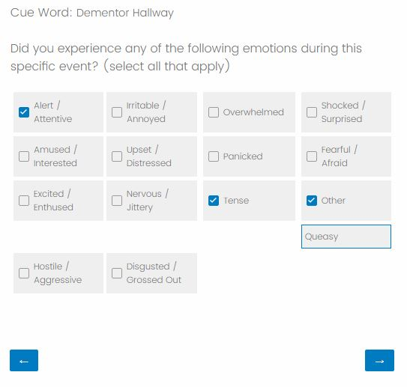
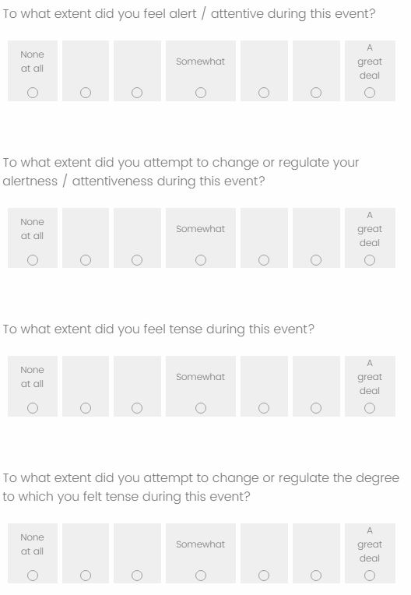
Relevant Measurements
Participants identify and describe 10 emotionally-evocative events
Emotions experienced
Intensity of those emotions
Extent of regulation for each emotion
Notes:
But before I get there, I just want to highlight our measurements. During the post-exposure session, every participant was asked to identify and describe the ten most emotionally salient events that they remember from their experience. For each event, we asked what emotions they experienced. If an emotion was endorsed, we asked how intense those emotions were on a scale of 1 to 7, with 1 being not at all and 7 being a great deal. Asking the participants to first endorse an emotion and then providing a “Not at all” option in the follow up provided us quality assurance that if an emotion was endorsed, it was not by mistake. Luckily, no participants endorsed experiencing an emotion and then selected 1 in the follow up.
We also asked participants how strongly they tried to regulate each of those emotion. To better approximate the experience of a lifelike stressful event, participants were not aware that they were being studied for emotion regulation and weren’t asked about their attempts to regulate their experiences until exposure was complete. TRASH:
For each event, we asked what emotions they experienced from a list of 13 options with an additional other option if they felt their experience was not captured by the available options

Slide 20
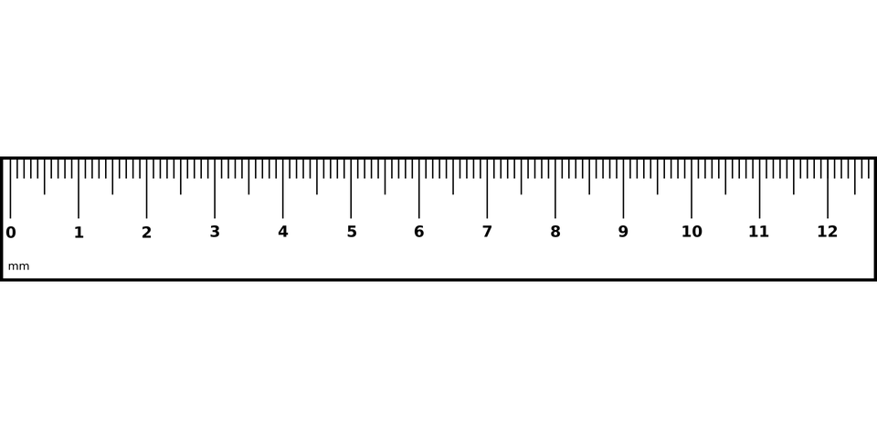
Relevant Measurements
Participants identify and describe 10 emotionally-evocative events
Emotions experiences
Intensity of those emotions
Extent of regulation for each emotion
Emotions measured based on modified PANAS¹⁵
Gold standard in emotion measurements
Can be limited in scope and redundant
Used their valence classifications
¹⁵ Watson et al., 1988
Notes:
The emotions chosen were modified from the PANAS, which is a gold standard emotion measure. It typically includes 20 emotions broken into positive and negative valence categories, but it can be limited and redundant for our purposes. Emotions like fear, disgust, and anger were classified as negative, while amusement, excitement, and enthusiasm were classified as positive. TRASH: There were some concerns that attentiveness, which is classified as positive on the PANAS, might hold a different valence in this context. After data collection, we performed a factor analysis to calculate Cronbach’s Alpha, which is an internal consistency measure telling us how strongly items relate to one another. Our positive grouping including attentiveness scored 0.80 and our negative groups scored 0.91 on a scale from 0 to 1.0. Both are strong scores, so we deferred to the PANAS valence categorizations.

Slide 21
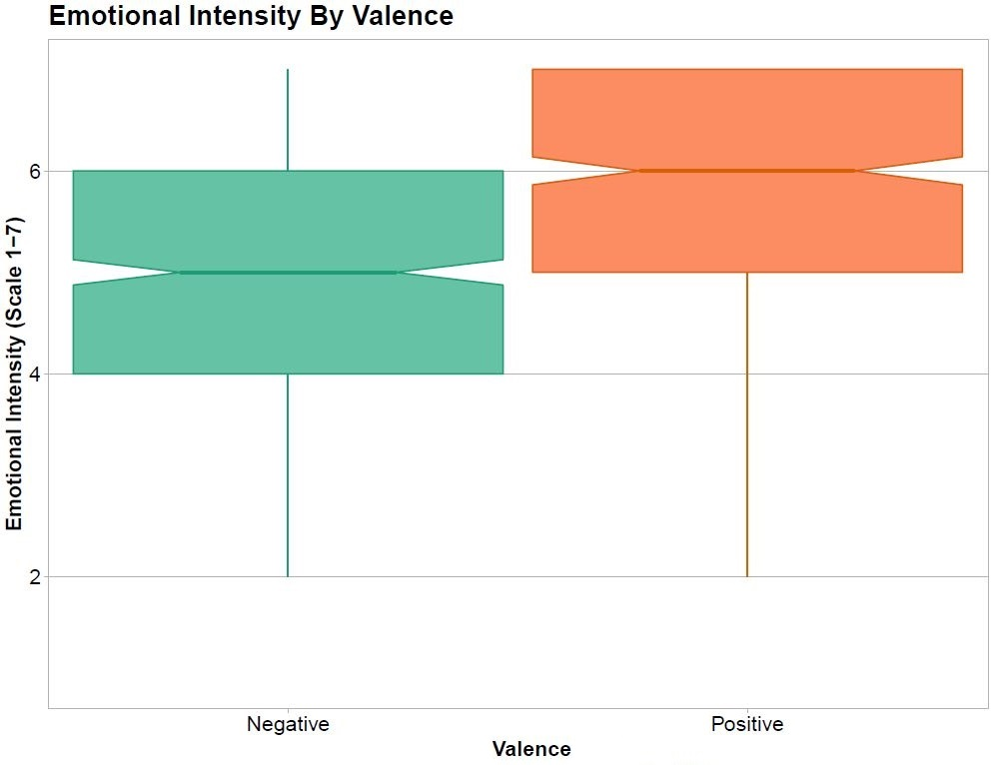
Our Manipulation Was Successful
***
***
Two one-sample t-tests demonstrated that exposure successfully produced responses in both positively [x̄ = 5.9 , sd = 1.19, t(524) = 113, p < 0.001] and negatively [x̄ = 5.4 , sd = 1.25, t(639) = 109, p < 0.001] valenced emotions.
ns = p > 0.1
‘ = p < 0.01
* = p < 0.05
** = p < 0.01
*** = p < 0.001
Notes:
To start our data dive, our manipulations worked superbly. Running a separate one sample t test for both positive and negative emotions supports the notion that people had sufficiently intense emotions in both categories. Surprisingly negative emotions were on average slightly less intense than positive emotions, at 5.4 and 5.9 respectively. These scrores again, were on a 1 to 7 scale.

Slide 22
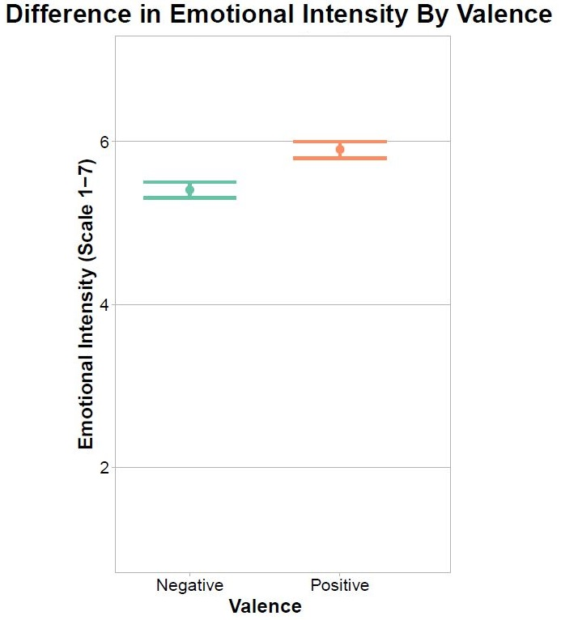
We Observed Differences in Emotional Intensity By Valence
***
A paired two sample t-test highlighted that the intensity of positive emotions [x̄ = 5.9] was significantly greater than that of negative emotions [x̄ = 5.9, t(1138) = -6.819, p < 0.001].
ns = p > 0.1
‘ = p < 0.01
* = p < 0.05
** = p < 0.01
*** = p < 0.001
Notes:
And the difference between the groups was significant as determined by a Paired Two Sample T-Test. A welch’s two sample t-test was run on the number of emotions endorsed by valence, which was not determined to be significant, at least statistically.
If we’re to assume that both intensity and valence have predictive value in determining how much we regulate, any differences between these groups might translate to differences in regulation as well.
TRASH: You might be wondering what the distribution of emotions looked like and they were surprisingly close, with negative emotions reported 640 times and positive emotions reported 525 times. So the average event included 1.05 positive emotions and 1.28 negative emotions.

Slide 23
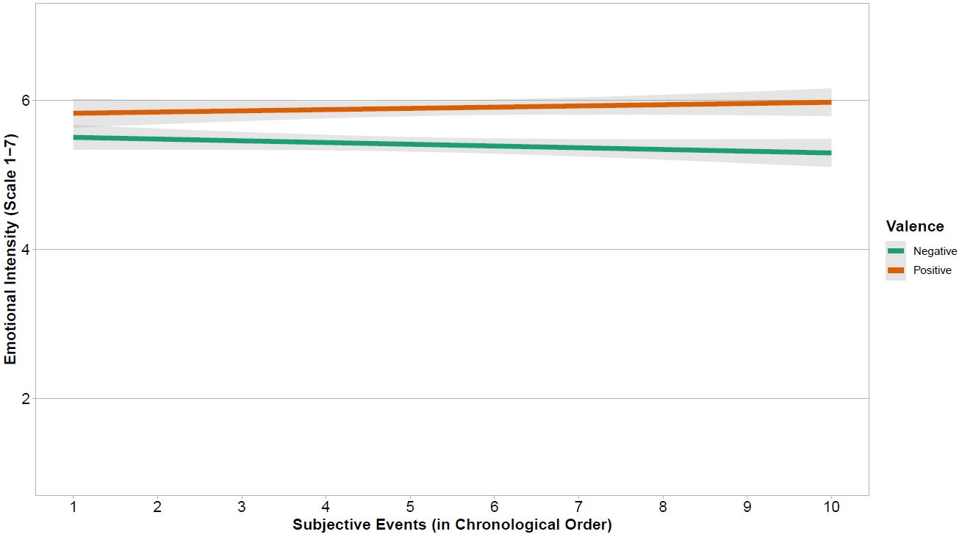
Emotional Intensity Was Sustained Throughout
Notes:
Furthermore when we look at intensity of emotion over time by valence, we see that, while there are differences in their trajectories, the intensity of both remained high throughout the experience, so I didn’t have concerns for the effect of time in these analyses. I’ve joked that if the labs ever start running low on funds, we could sell these plot to the ad people at Terror Behind the Walls as a nice endorsement of their setup.

Slide 24
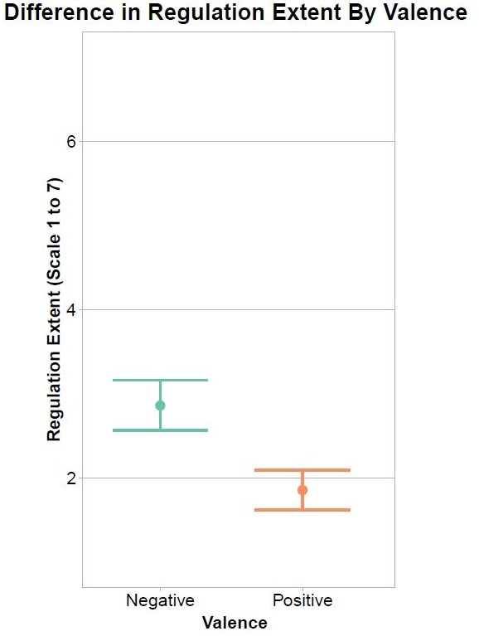
We Observed Differences in Regulation Extent By Valence
A paired two sample t-test found regulation extent reported for positive emotions [x̄ = 1.8, sd = 1.46] was significantly greater than that of negative emotions [x̄ = 3.64, sd = 1.75, t(48) = 8.000,
p < 0.001].
***
ns = p > 0.1
‘ = p < 0.01
* = p < 0.05
** = p < 0.01
*** = p < 0.001
Notes:
When we look at how regulation differs by valence, we begin to get a sense for the relationship. Regulation was reported with less intensity than emotion, but again, we see a difference between positive and negative emotions. This time, negative emotions were reported being regulated to a greater extent.

Slide 25
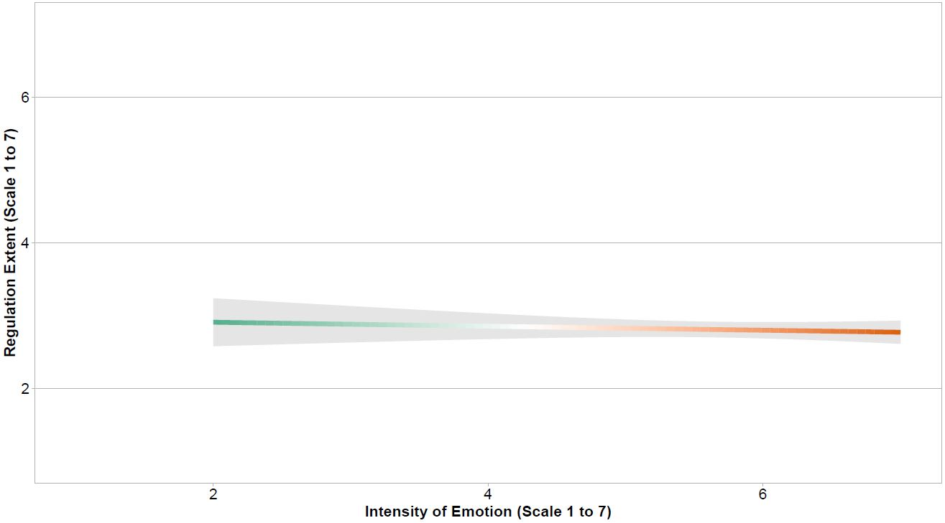
Emotional Intensity Alone Does Not Predict Regulation Extent
Intensity alone fails to be predictive of how much we regulate.
[F(1,1163) = 0.394, b = -0.018, 95% CI (-0.104, 0.067),
r_{adj.} =.001, p > 0.1]
Notes:
And if we were to first start looking at intensity alone, independent of valence, we’d see absolutely no relationship in a bivariate regression, so we know valence is likely an important factor in this equation.

Slide 26
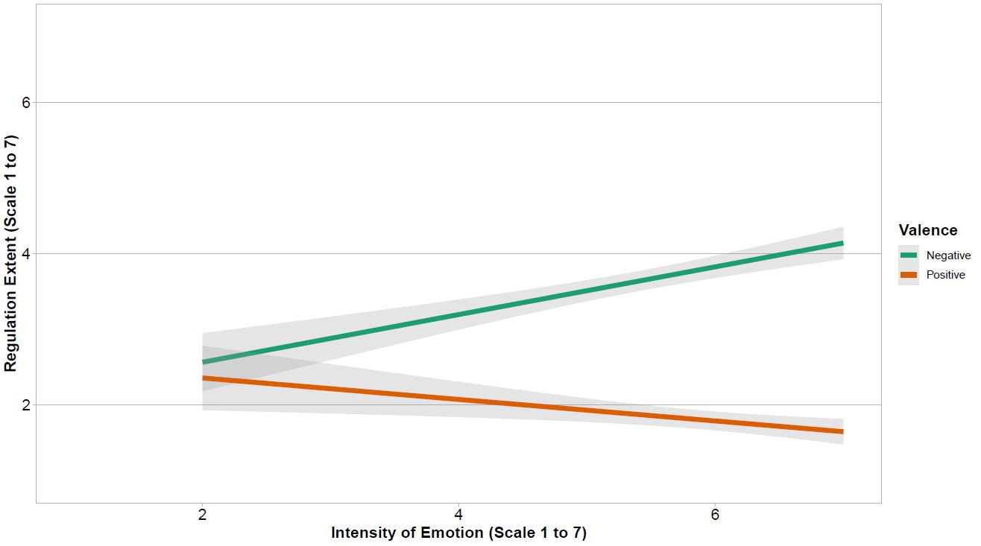
Intensity / Valence of Emotion Predicts Regulation Extent
When we add valence to the relationship between emotional intensity and regulation extent, we find a significant interaction.
[F(3,1161) = 142.000, b = -0.746, 95% CI (-0.898, -0.595),
r_{adj.} =.267, p < 0.001]
Notes:
Taking the analyses a few steps further, using multivariate regression, we find the interaction between intensity and valence demonstrates significant predictive value for the extent of regulation reported. As negative intensity increases, our attempts to regulate them do as well. As positive intensity increases our attempts to regulate them decrease.

Slide 27
Valence Moderates Intensity and Regulation Extent
A simple slopes moderation analysis suggests valence is moderating this relationship.
Positive [b = -0.14, t(1161)= -2.43, p = 0.02] and negative valences [b = 0.31, t(1161)= 6.26, p < 0.001] both demonstrated significance.
ns
¹⁶ Weiss et al., 2015
¹⁷ Cyders et al., 2012
¹⁸ Cyders et al., 2007
¹⁹ Billieux et al., 2010
Notes:
And I think that this is fairly common sensical on the surface. If I were to ask you right now what you’d do with any negative feelings you have, I’d bet money you’d want to reduce them, and that looks like it hits the nail on the head. But what this positive line seems to suggest is that we have a “don’t fix what isn’t broken” mentality. If we’re experiencing intense positive emotions, we don’t necessarily work to try to maximize them. So when people are feeling good, they don’t press their luck by trying to feel better, it seems. There’s also an argument to be made for downregulating positive emotion in this context. A number of studies suggest intense positive emotions reduce focus on details, impulse control, and goal-oriented activities, so you might be setting yourself up for greater fear or danger by not being ready for it. We seem to more readily alter our negative emotions than our positive ones.

Slide 28
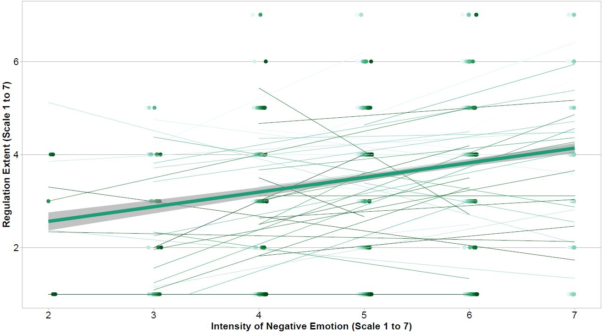
Intensity of Negative Emotion Predicts Regulation Extent
Model of Best Fit:
[ Regulation ~ Emotion + (Emotion | Participant)]
Negative emotional intensity demonstrated predictive value towards
regulation extent while accounting for individual differences
[b = 0.2648, 95% CI(0.124, 0.403), p < 0.001].
Notes:
But a standard multivariate regression doesn’t allow us to adjust for factors that might hide our true effect sizes like individual differences and dependencies in our measurements. Next, we divided the dataset by valence and created multilevel models, which do allow us to make these adjustments. Unfortunately, I don’t have the time to describe the multilevel model testing process, but the model that fit our data best suggests not only that negative intensity predicts regulation, and not only that there are individual differences, but that individuals have their own unique regulation trajectories as emotional intensity changes. On average, though, we still see that pattern that as intensity increases, regulation extent increases as well. This is represented by the fat green line with the grey confidence interval. The thinner lines represent the experiences of individuals.
TRASH: Typically this process mirrors your typical ANOVA or T-Test. You create a model that would fit best if our effect were better attributed to random chance than anything we’re measuring. This is our null model. We then compare this to our experimental model and determine how likely it is that our experimental model would better fit the data if the null model were true. In our case, we created a null model and also created a model that would fit best if there were a relationship of emotion on regulation and if there were individual differences within that effect, but that as emotion changed, everyone responded by regulating pretty much in the same way. The slopes of the change would be the same, but the intercepts would be different.

Slide 29
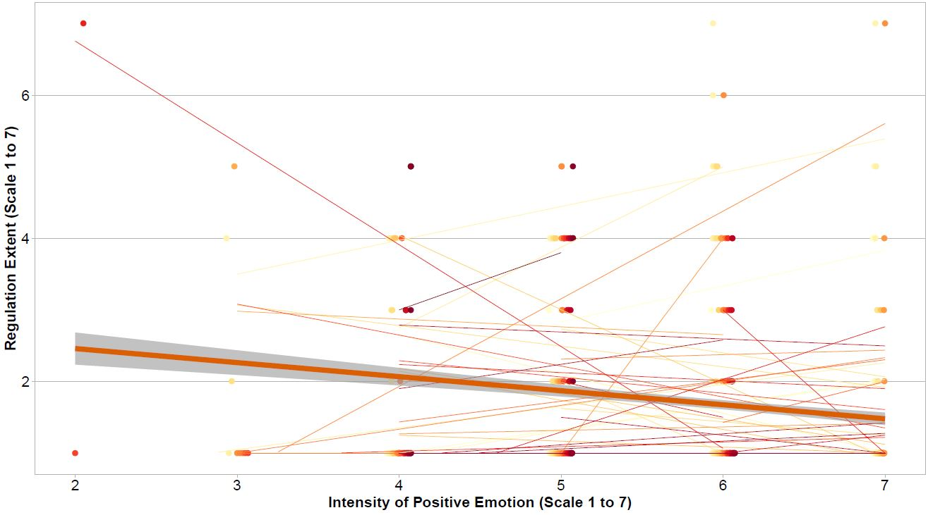
Intensity of Positive Emotion Does Not Predict Regulation Extent
Model of Best Fit:
[ Regulation ~ Emotion + (Emotion | Participant)]
Model of Best Fit:
[ Regulation ~ Emotion + (Emotion | Participant)]
Positive emotional intensity DID NOT predict regulation extent
while accounting for individual differences
[b = -0.0429, 95% CI(-0.180, 0.0943), p = 0.53].
¹⁶ Weiss et al., 2015
²⁰ Alves et al., 2015
²¹ Koch et al., 2016
²² Chavez & Heatherton, 2015
Notes:
The process was repeated for positive intensity and we found the same best fitting model. However, in this case, there was too much variability to say that emotional intensity predicted regulation extent. It could certainly still be the case that some individuals demonstrate a pattern, but broadly, there’s too much variably to make predictions as a whole. There are studies suggesting synchronicity differences in neural representations and behavioral responses by valence, but as best as I can tell, the debate is pretty lively. The studies that actually have focused on positive emotion regulation have documented this phenomenon of negative views held towards positive emotions. Some participants reported them as undesirable, unpredictable and frightening. This asymmetry by valence in the diversity of opinions held towards emotions may help explain why negative emotions shows predictive value here, but not positive emotions and this complication is going to be a really interesting challenge for future work. Of course, adjust for individual’s personal emotional goals will likely reduce some of this variability and we actually do have the data to do this in our future analyses.

Slide 30
Take Home Points
Valence is important in understanding the relationship between emotional intensity and regulation
As negative emotions increase in intensity, our attempt to regulate those emotions increase as well
Positive emotional intensity DID NOT predict regulation extent while accounting for individual differences
Notes:
For now, though, what we can say is that valence is important in the discussion about the relationship between emotional regulation and emotional intensity. It seems we can predict regulation extent by negative intensity, but we can’t say the same about positive emotional intensity.

Slide 31
Notes:
But there’s a lot more that this dataset and study design can tell us. Here, we’re measuring people’s emotional reactions to zombie hordes, creepy hallways, and sensory-overload, but the hope is that

Slide 32
Notes:
from this, we can better understand how to maintain awareness of our circumstances in the face of danger, maintain self-control when it’s especially challenging, and mitigate the impact of high-intensity stressors. Our findings today highlight that research on this interaction of emotion, memory, and physiology can produce meaningful guidance for the practices and treatments already in use. I’ve focused heavily on survey data here, but Joanne can build upon this with some surprising outcomes when using heart rate and heart rate variability as key biological markers.

Slide 33
Citations
Gross, J. J. (1998). The Emerging Field of Emotion Regulation: An Integrative Review. Review of General Psychology, 2(29), 271-299.
Morawetz, C., Mohr, P. N. C., Heekeren, H. R., & Bode, S. (2019). The effect of emotion regulation on risk-taking and decision-related activity in prefrontal cortex. Social Cognitive and Affective Neuroscience, 14(10), 1109–1118.
Hefner, K. R., Verona, E., & Curtin, John. J. (2016). Emotion regulation during threat: Parsing the time course and consequences of safety signal processing: Safety signals and emotion regulation. Psychophysiology, 53(8), 1193–1202.
Carpenter, R. W., & Trull, T. J. (2013). Components of Emotion Dysregulation in Borderline Personality Disorder: A Review. Current Psychiatry Reports, 15(1), 335.
Eftekhari, A., Zoellner, L. A., & Vigil, S. A. (2009). Patterns of emotion regulation and psychopathology. Anxiety, Stress & Coping, 22(5), 571–586.
Seligowski, A. V., Lee, D. J., Bardeen, J. R., & Orcutt, H. K. (2015). Emotion Regulation and Posttraumatic Stress Symptoms: A Meta-Analysis. Cognitive Behaviour Therapy, 44(2), 87–102.
McLean, C. P., & Foa, E. B. (2017). Emotions and emotion regulation in posttraumatic stress disorder. Current Opinion in Psychology, 14, 72–77.
Ilan, S., Tamuz, N., & Sheppes, G. (2019). The fit between emotion regulation choice and individual resources is associated with adaptive functioning among young children. Cognition and Emotion, 33(3), 597–605.
Shafir, R., Thiruchselvam, R., Suri, G., Gross, J. J., & Sheppes, G. (2016). Neural processing of emotional-intensity predicts emotion regulation choice. Social Cognitive and Affective Neuroscience, 11(12), 1863–1871.
Sheppes, G., Scheibe, S., Suri, G., & Gross, J. J. (2011). Emotion-Regulation Choice. Psychological Science, 22(11), 1391–1396.
Ochsner, K. N., Bunge, S. A., Gross, J. J., & Gabrieli, J. D. E. (2002). Rethinking Feelings: An fMRI Study of the Cognitive Regulation of Emotion. Journal of Cognitive Neuroscience, 14(8), 1215–1229.
Colombo, D., Fernández-Álvarez, J., García Palacios, A., Cipresso, P., Botella, C., & Riva, G. (2019). New Technologies for the Understanding, Assessment, and Intervention of Emotion Regulation. Frontiers in Psychology, 10, 1261.
Haines, S. J., Gleeson, J., Kuppens, P., Hollenstein, T., Ciarrochi, J., Labuschagne, I., Grace, C., & Koval, P. (2016). The Wisdom to Know the Difference: Strategy-Situation Fit in Emotion Regulation in Daily Life Is Associated With Well-Being. Psychological Science, 27(12), 1651–1659.
Bylsma, L. M., & Rottenberg, J. (2011). Uncovering the dynamics of emotion regulation and dysfunction in daily life with Ecological Momentary Assessment. In I. Nykliček, A. Vingerhoets, & M. Zeelenberg (Eds.), Emotion regulation and well-being (p. 225–244). Springer Science + Business Media.
Watson, D., Clark, L. A., & Tellegen, A. (1988). Development and validation of brief measures of positive and negative affect: The PANAS scales. Journal of Personality and Social Psychology, 54(6), 1063–1070.
Weiss, N. H., Gratz, K. L., & Lavender, J. M. (2015). Factor Structure and Initial Validation of a Multidimensional Measure of Difficulties in the Regulation of Positive Emotions: The DERS-Positive. Behavior Modification, 39(3), 431–453.
Cyders, M.A. & Coskunpinar, A. (2012). The relationship between self-report and lab task conceptualizations of impulsivity. Journal of Research in Personality, 46, 121–24.
Cyders, M.A., Smith, G.T., Spillane, N.S., Fischer, S., Annus, A.M., & Peterson, C. (2007). Integration of impulsivity and positive mood to predict risky behavior: development and validation of a measure of positive urgency. Psychological Assessment, 19, 107–18.
Billieux, J., Gay, P., Rochat, L., & Van der Linden, M. (2010). The role of urgency and its underlying psychological mechanisms in problematic behaviours. Behavioral Research & Therapy, 48, 1085–96.
Alves, H., Unkelbach, C., Burghardt, J., Koch, A. S., Krüger, T., & Becker, V. D. (2015). A density explanation of valence asymmetries in recognition memory. Memory & Cognition, 43(6), 896–909.
Koch, A., Alves, H., Krüger, T., & Unkelbach, C. (2016). A general valence asymmetry in similarity: Good is more alike than bad. Journal of Experimental Psychology: Learning, Memory, and Cognition, 42(8), 1171–1192.
Chavez, R. S., & Heatherton, T. F. (2015). Representational Similarity of Social and Valence Information in the Medial pFC. Journal of Cognitive Neuroscience, 27(1), 73–82.

Slide 34
Project Introduction
Rationale
Methods
Measures
How does emotional and physiological arousal inform perceptions?
When does emotion predict regulation?

Slide 35
Joanne Stasiak
Arousal Aristotle
Question:
How does emotional and physiological arousal inform perceptions?
Measures Used:
From Haunted House:
Heart Rate Measures
Fear Ratings of Sections
From Follow-up Session:
Post-Exposure Questionnaires

Slide 36
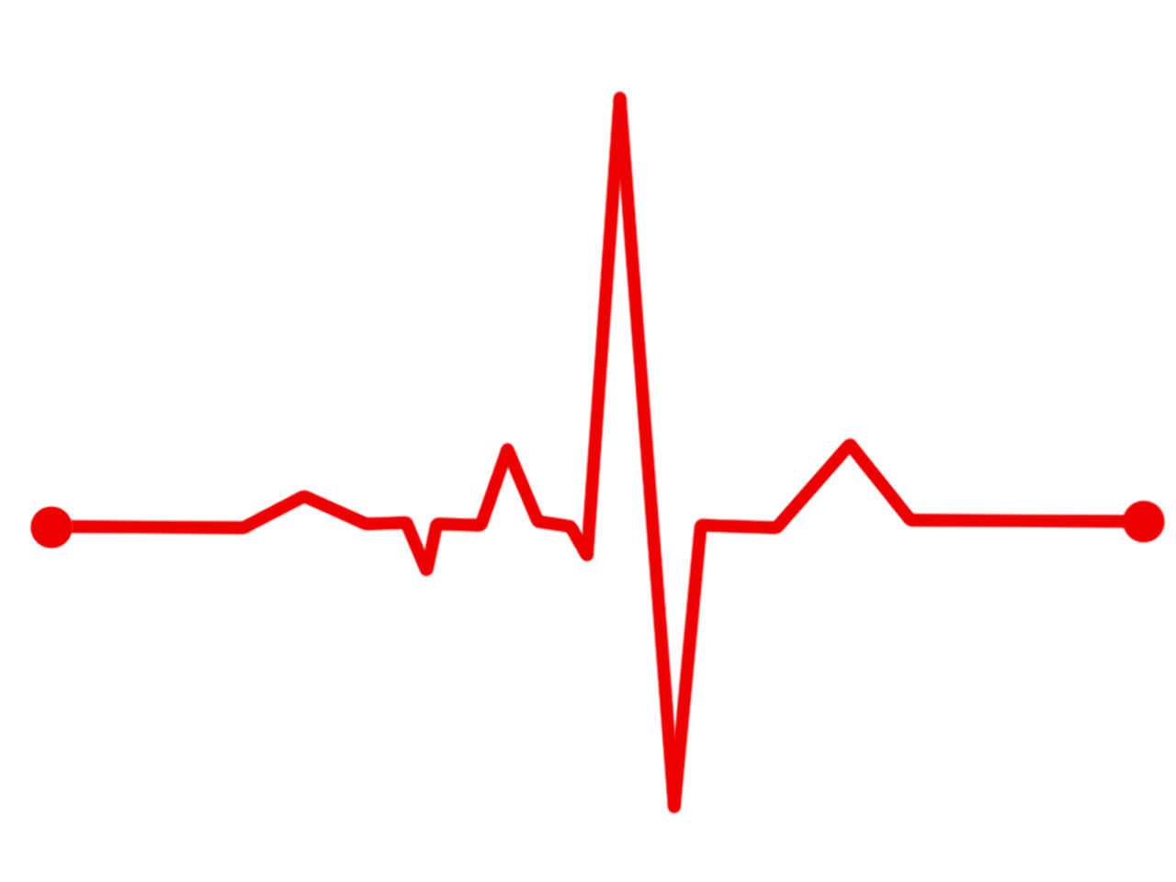
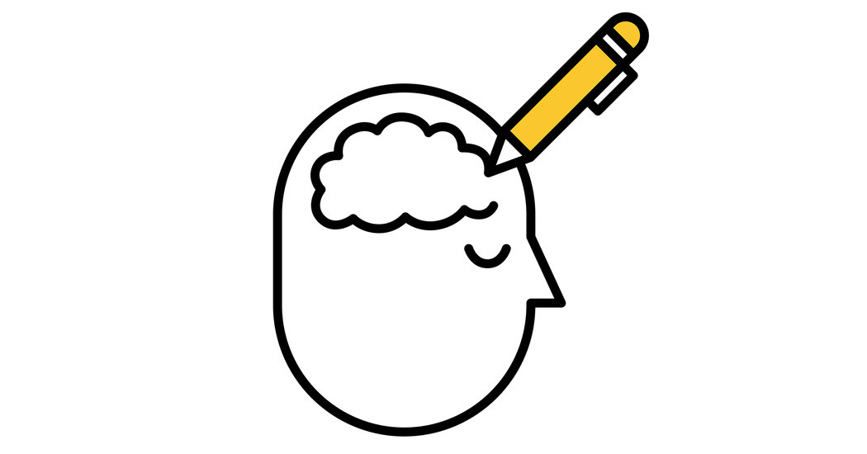
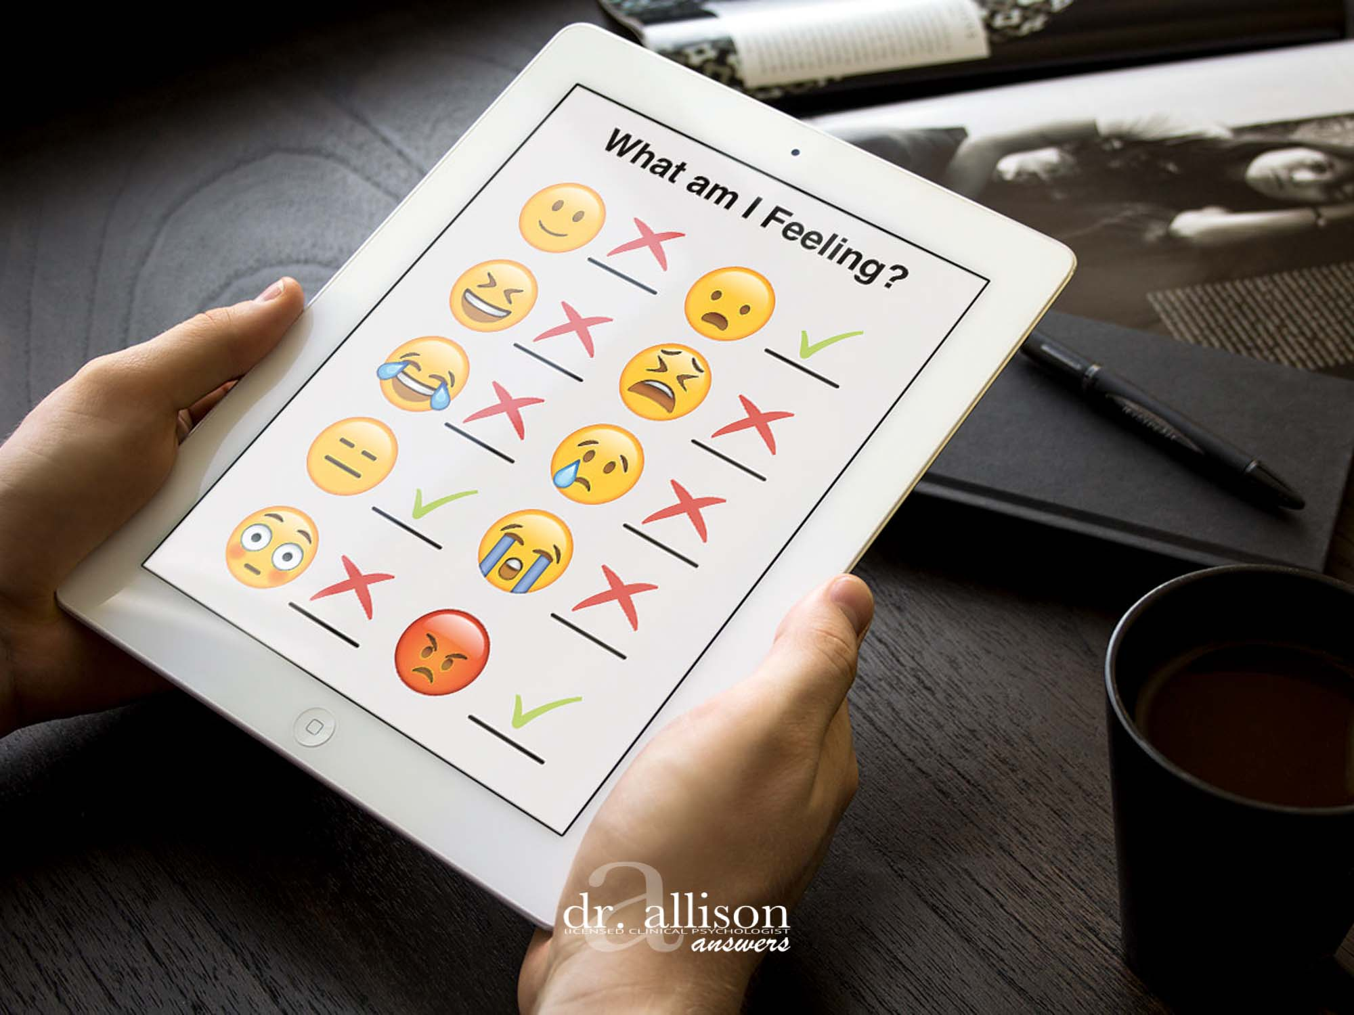
Research Questions
How do emotional and physiological arousal guide current appraisals of an experience?
How do these factors align with later recall of the same experience?

Slide 37




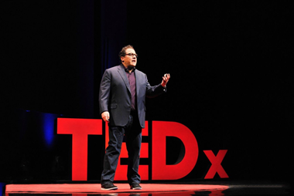
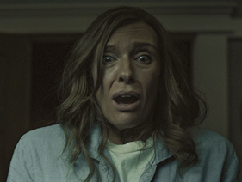
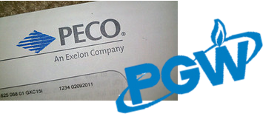
Emotional and Physiological Responses to Arousing Naturalistic Experiences
Emotion-eliciting stimuli increase physiological arousal (Wu et al., 2019; Wang et al., 2016; Choi et al., 2017)
Immersion heightens these effects (Nakahara et al., 2009; Chirico et al., 2017; Weeks & Zoccola, 2016)

Slide 38


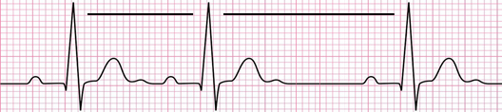
Heart rate variability (HRV) as a psychophysiological
measure of regulation
HRV refers to the differences in time between subsequent heart beats
When we calculate HRV, we’re measuring parasympathetic nervous system (PNS) activity
PNS acts as a heart-brake
Higher HRV is representative of a greater PNS response (Ernst, 2017; Shaffer & Ginsberg, 2018)
Lower HR → More time between beats, making room for more variability
between beats → Greater HRV
Higher HR → Less time between beats, less room for variability between
beats → Lower HRV
Measured by RMSSD
PNS
Widely considered a measure of autonomic regulation (Holzman & Bridgett, 2017)
Has been implicated in emotion regulation research; Neurovisceral integration model (Williams et al., 2015; Mather & Thayer, 2018; Thayer & Lane, 2009)

Slide 39
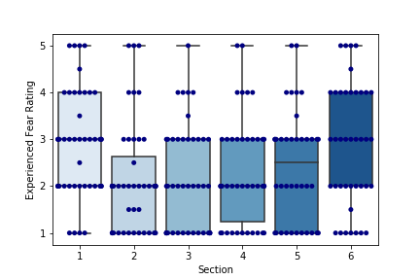
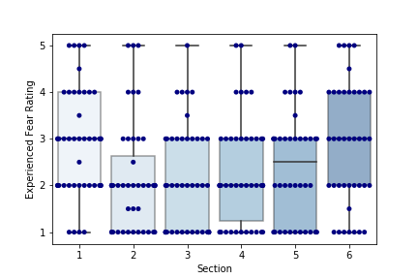
The haunted house successfully elicited fear!
A one-sample t-test indicated that the participants did experience fear responses
(M = 2.44 , SD=1.19, t(251) = 32.73, p < 0.001)
A one-way ANOVA revealed ratings from the first section of the haunted house (M=2.85,
SD = 1.12) to be significantly higher than ratings in the second (M=2.13, SD=1.14, t(256)=2.93, p=0.042) and third (M=2.11,
SD= 1.12, t(256) = 2.99, p=0.035) sections.
Not scary at all Extremely scary

Slide 40
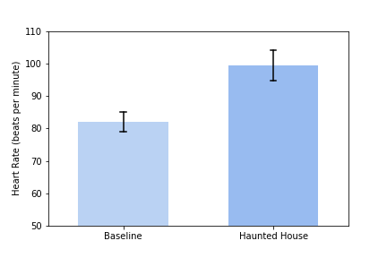
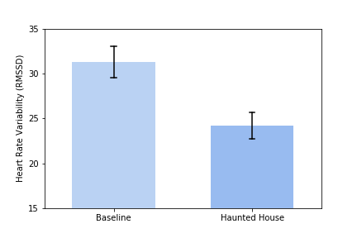
The haunted house elicited significant physiological responses
***
***
A paired-samples t-test found heart rate to be significantly higher during the haunted house (M=99.48, SD=16.19) as compared to the baseline condition (M=81.97, SD=11.78, t(51)= -10.039, p<0.001).
A paired-samples t-test revealed heart rate variability to be significantly higher in the baseline recording (M=31.24, SD=13.45) relative to the haunted house (M=24.20, SD=11.15), t(51)=4.6328, p<0.001

Slide 41
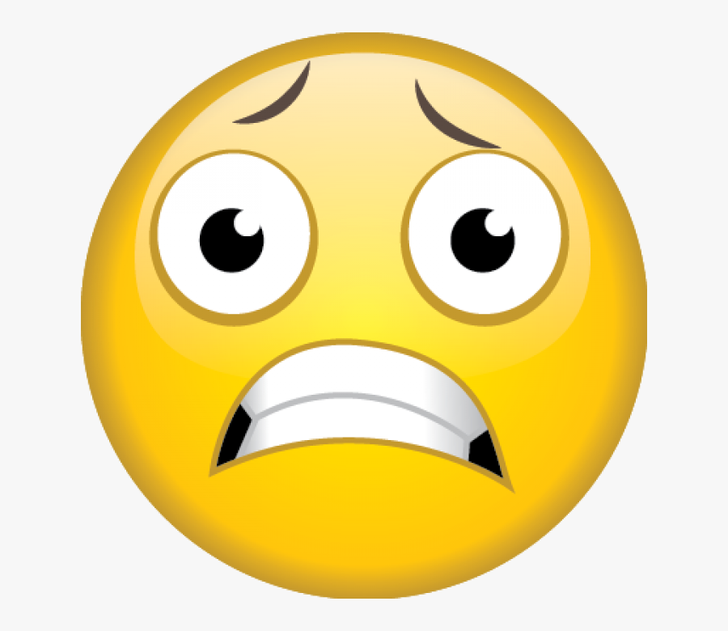

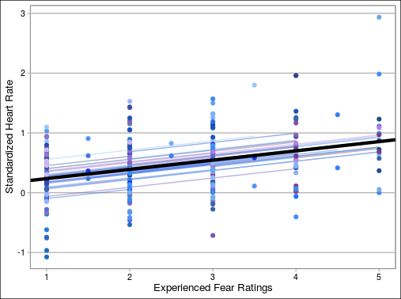
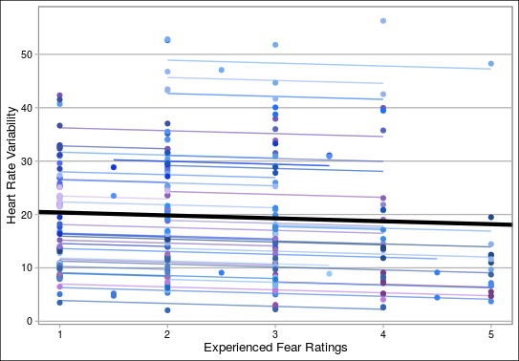
Emotional and physiological arousal are significantly,
positively associated
A multilevel model revealed self-reported fear ratings to significantly predict real-time heart rate (β (252) = 0.15484, 95% CI[0.098, 0.212], p<0.001).
A multilevel model revealed self-reported fear ratings to significantly predict real-time heart rate variability ( β (252) = -0.5485, 95% CI[-1.095, -0.005], p<0.05)

Slide 42
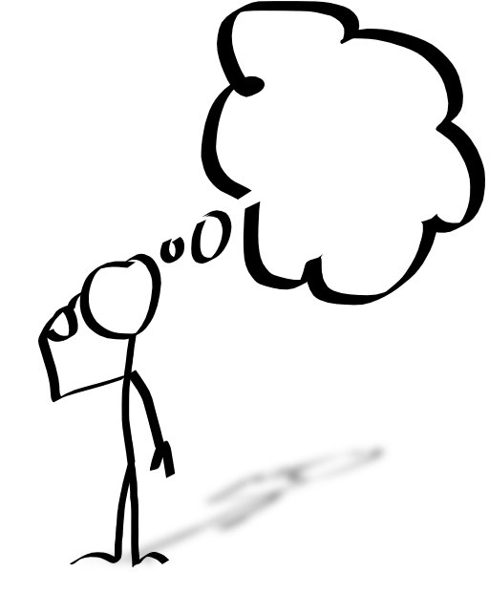
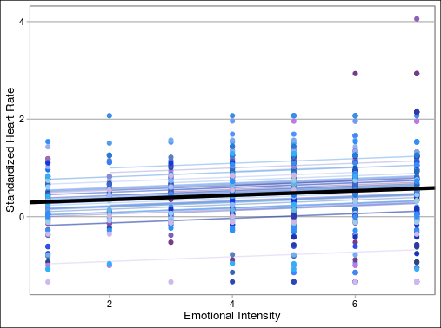
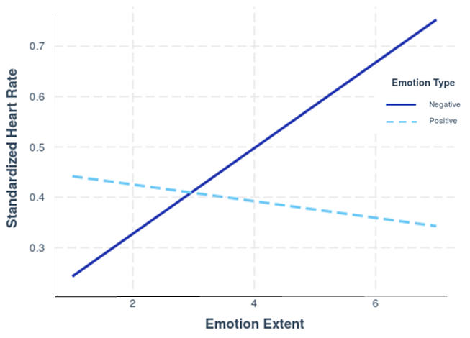
Recalled emotional intensity is significantly associated
with physiological responses in the haunted house
Emotional Intensity
Self-reported emotional intensity ratings were significantly associated with physiological arousal in the haunted house (β (1121) = 0.04509, 95% CI[0.028, 0.069], p<0.001).
A moderation analysis revealed this effect to be driven by negative emotions (β=0.10084, t(943)= 2.86, p=0.004)

Slide 43

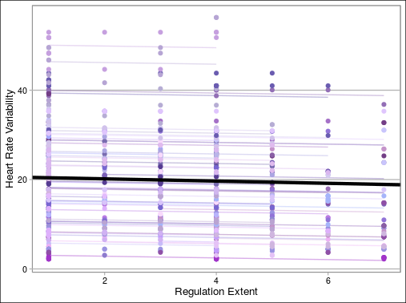
Self-reported and autonomic regulation are
inversely related
Prior research has demonstrated a gap between behavior and metacognitive beliefs about self-regulation (Zimmerman, 1995).
Events reported as being regulated to a greater extent were significantly associated with lower heart rate variability in the haunted house
(β (1121) = -0.18829, 95% CI[-0.343, -0.034], p=0.0173)

Slide 44
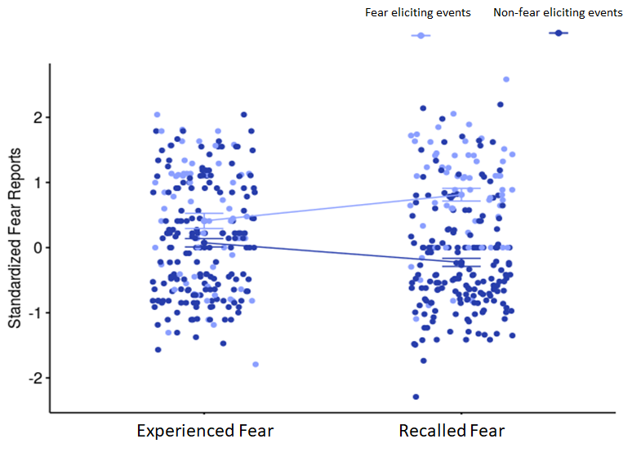
There is a systematic divergence in recalled
fear intensity
Past research has shown directional changes in recalled intensity based on valence (Lench & Levine, 2010).
A two-way ANOVA revealed a significant difference in self-reported fear by endorsement (F(1) = 60.990, p<0.001), but not by rating type (i.e, haunted house and follow-up) (F(1)=2.094, p=0.149). However, the interaction between these terms was significant (F(1)=16.431, p<0.001).
Tukey’s HSD revealed that fear-eliciting events endorsed with fear were recalled as being significantly more scary in the haunted house relative to non-fear eliciting events (p<0.001). Furthermore, fear eliciting events were recalled as being more intense than experienced (p=0.035), while non-fear eliciting events were recalled as being less scary than experienced (p=0.004).

Slide 45
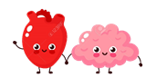
Summary
● Experienced and recalled emotional intensity were predicted by physiological
arousal in the haunted house
● An inverse relationship was found between between autonomic and self-reported
regulation
● A discrepancy in fear reports was governed by the emotional categorization
(fear-eliciting or non-fear eliciting) of experiences by participants
Yikes, that was scary!
Wow, that was fun!

Slide 46
Project Introduction
Rationale
Methods
Measures
How does emotional and physiological arousal inform perceptions?
Does emotion predict regulation?
How do emotion and arousal affect the details you remember?
Notes:
Subjective memory for emotional intensity and the amplifications of memory for fearful experience

Slide 47
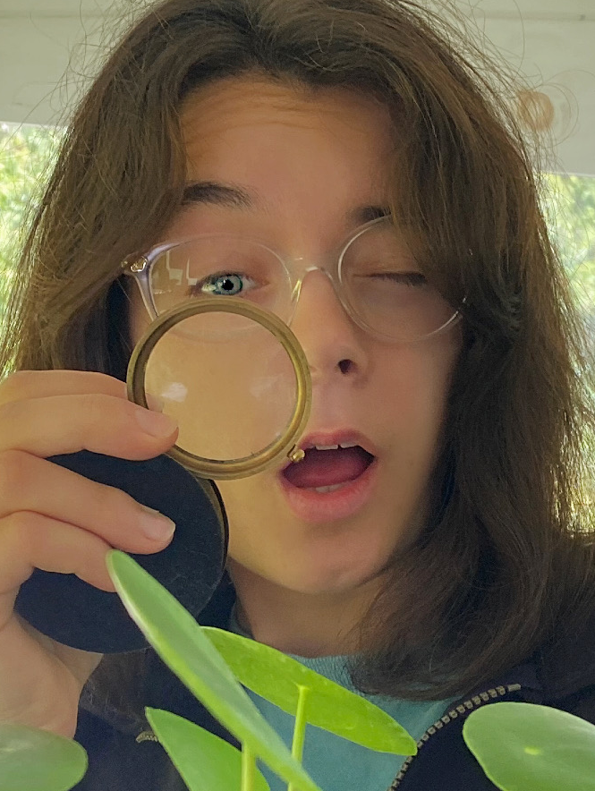
Samantha Reisman
Detail Duchess
Question:
How do emotion and arousal affect what you remember?
Measures Used:
Free Recall Transcripts
Heart Rate Data
Notes:
Based off of joanne’s work, we now that subjective memory for experienced fear is inflated or reduced depending on the extent of fear during encoding.
My work focuses objective measures of memory, and look at how emotion and arousal affect what parts of memory persist and remain salient during later recall

Slide 48
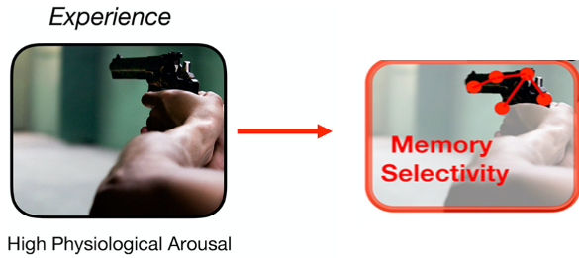
Arousal and Memory
Emotion and arousal drive attentional resources towards central details and away from peripheral details.^{1,2,3,4}
Clewett & Murty, 2019
Emotion enhances item memory and memory confidence, at the expense of memory for peripheral features of a stimulus.^{4,5,6,7,8}
Heuer & Reisberg (1992, 2004)
Mather (2007)
Yonelinas & Ritchey (2015)
Clewett & Murty (2019)
Rimelle et al. (2014)
Rimelle et al. (2011)
Kensinger & Corkin (2004)
Kensinger et al. (2007)
Kensinger et al. (2005)
Notes:
General theory concerning arousal and memory is that under states of arousal, your attention is driven towards the source of the arousing stimulus and diverted of surrounding details.
Real world example - robbed at gun point
Results seen in the lab
item memory and memory confidence, at the expense of features of source memory peripheral to a negative image^{4,5}
Emotion enhances memory for visual details, such as the color of words presented⁶
Emotion enhances recognition memory, with no enhancement for memory for stimulus-associated task (size/animacy questions) ^{7,8}
Many tasks used capture relative info about memory specificity, but we still don’t really know what details of a memory are prioritized in fearful situations

Slide 49
Research Questions
What aspects of memory are enhanced and impaired in a highly—arousing naturalistic event?
What is the moderating role of physiological arousal on emotional memory biases?

Slide 50
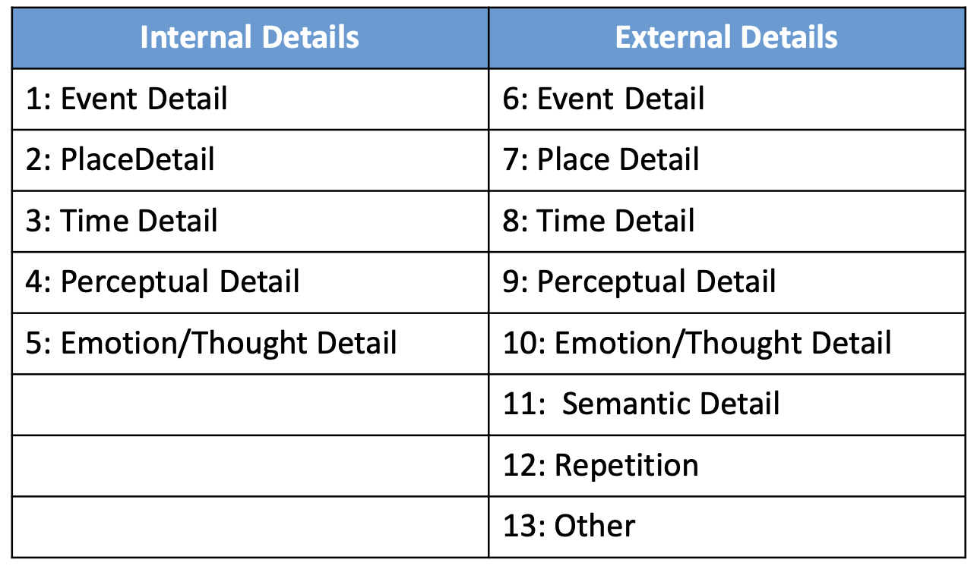
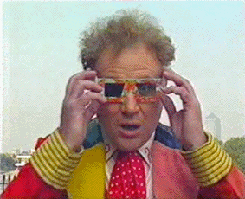


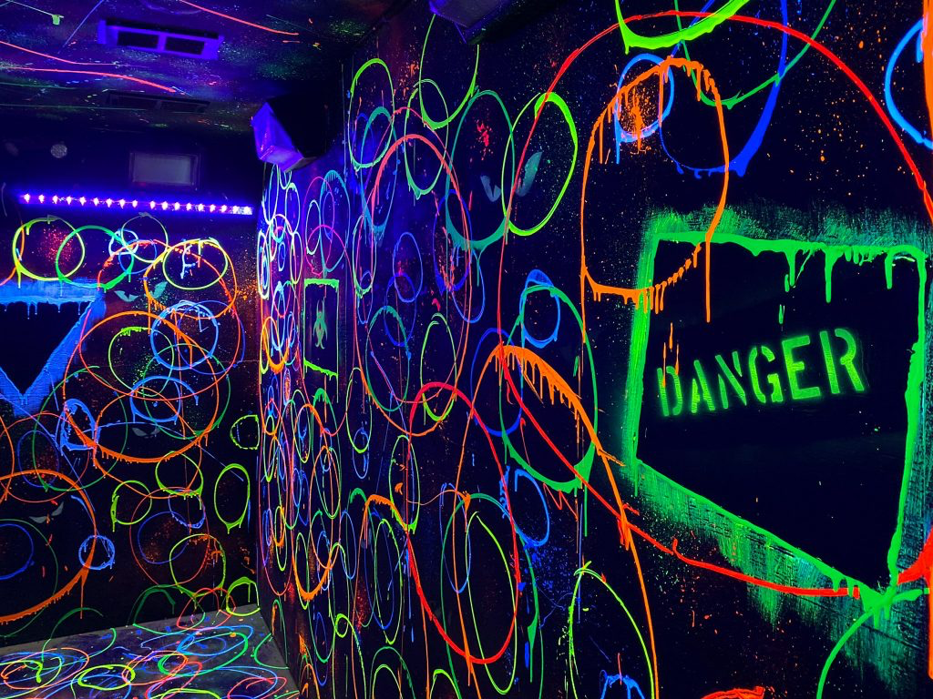

Autobiographical Interview Scoring Method
^{Levine et al. (2002)}
Event
Place
Time
Perceptual
Emotion/Thought
Notes:
AI is used for scoring free recall transcripts (when you can’t capture accuracy)
Traditionally used for someone remembering an event, the orginal paper captures aging
Target even

Slide 51
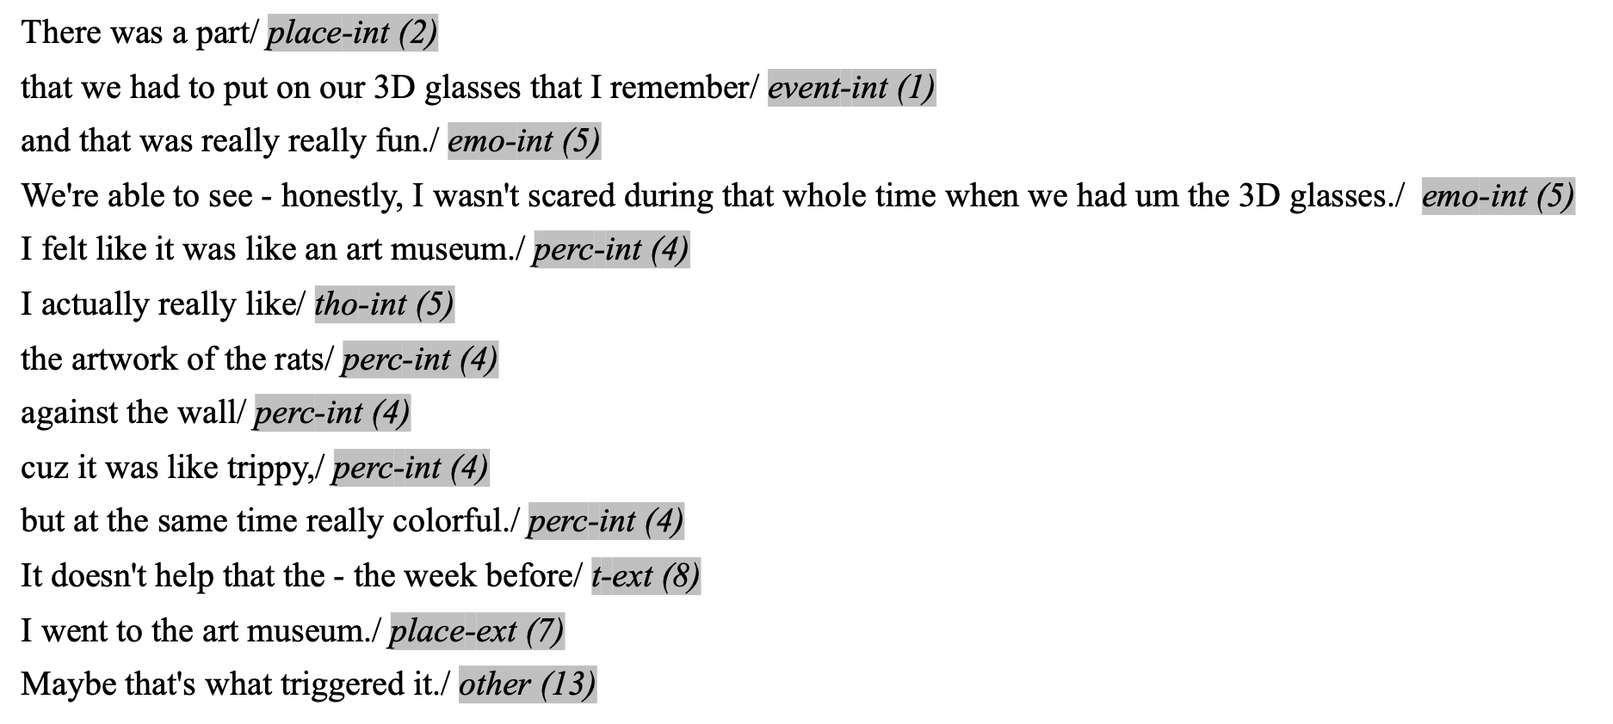
Example scored Haunted House transcript

Slide 52
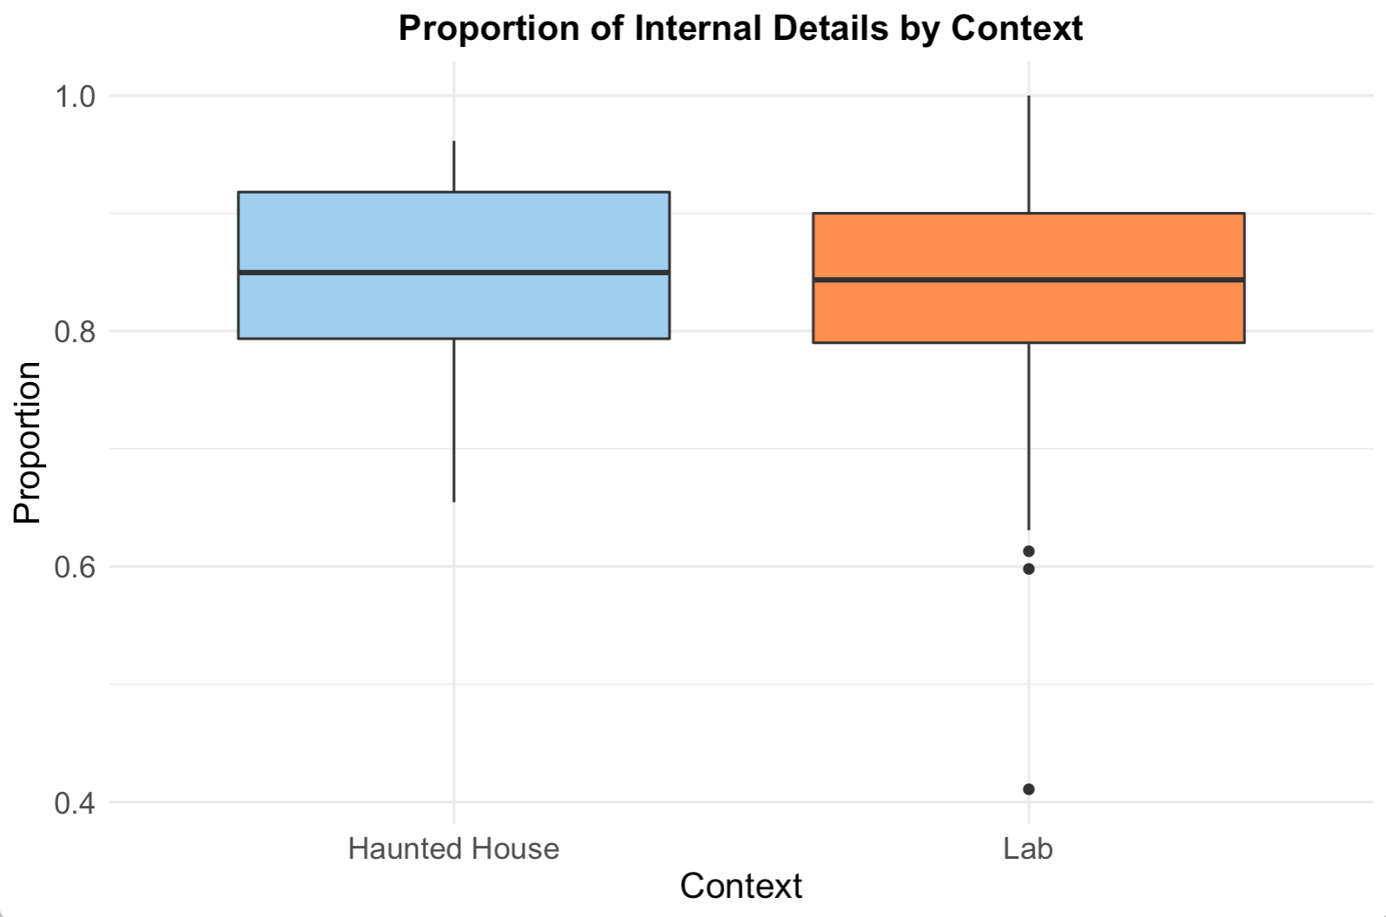
Episode-specific memory persists across contexts.
Context does not affect the proportion of internal details to all details (t(46)=.49, p=.71).
HH (M=.85, SD =.08), Lab (M=.85, SD =.12).
Notes:
Across contexts, people’s the majority of details in people’s memories contained details about the target event
Gave us pages of detail about their superbowl sunday

Slide 53
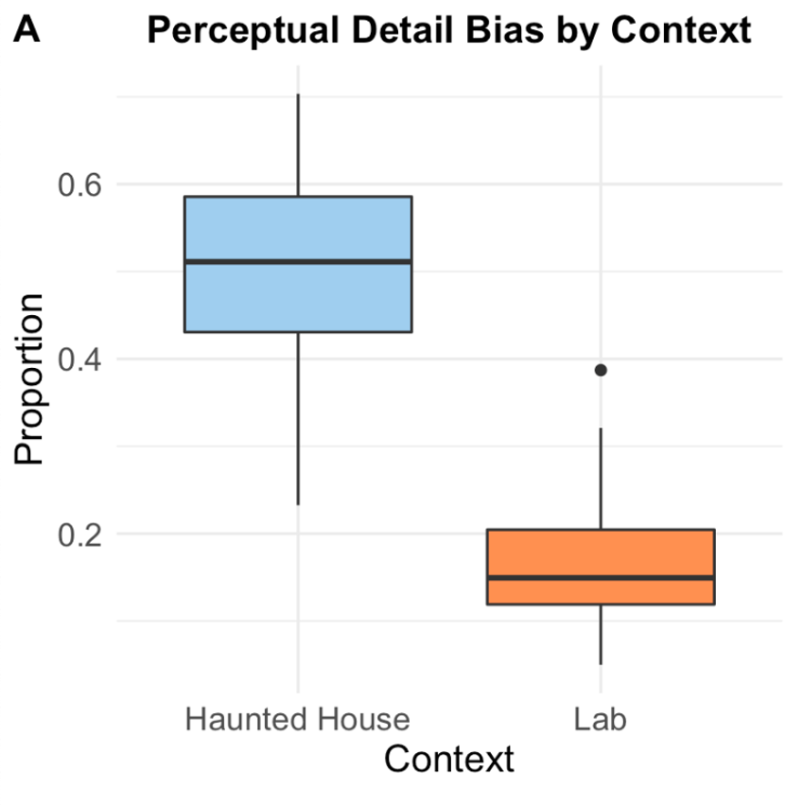

Context affects later memory for details in the perceptual field.
Context affects proportion of perceptual details recalled (t(44)=.49, p<.001) where there is a higher proportion of perceptual details reported in HH (M=.5, SD=.11) than lab (M=.17, SD=.07)

Slide 54
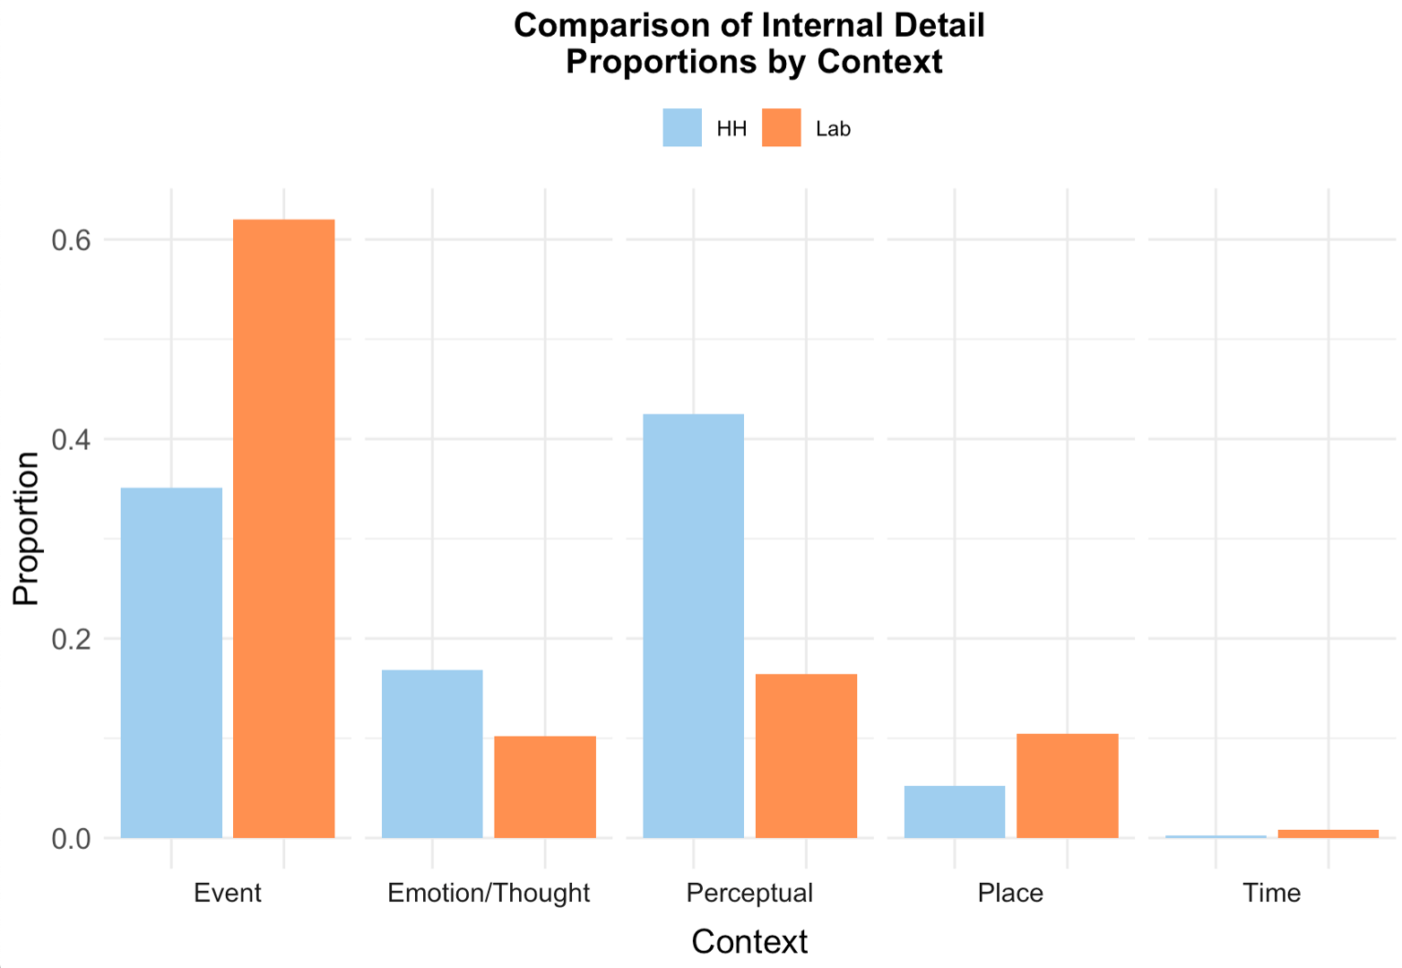
Context affects memory for perceptual details and overarching patterns in detail differences.
Individuals in the haunted house reported significantly more perceptual details (n = 2732, percentage = 42.5%) than would be expected by chance, χ2(4, N = 5952) = 3900.107, p<.001).

Slide 55
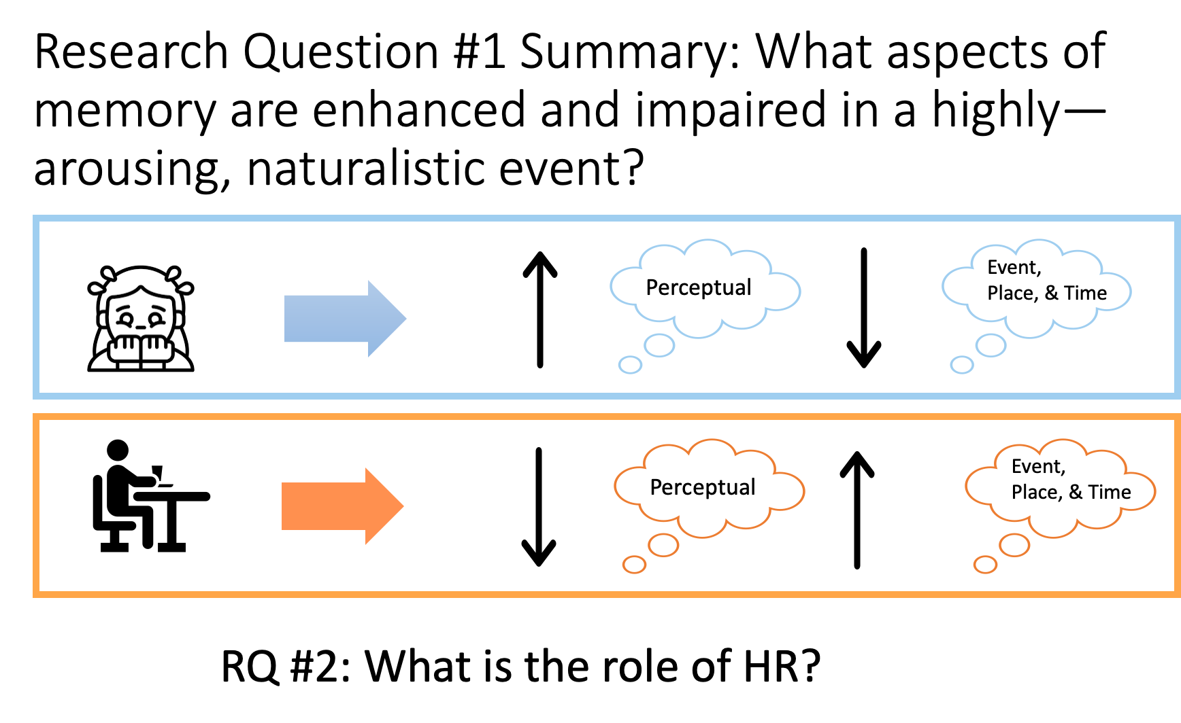


Slide 56
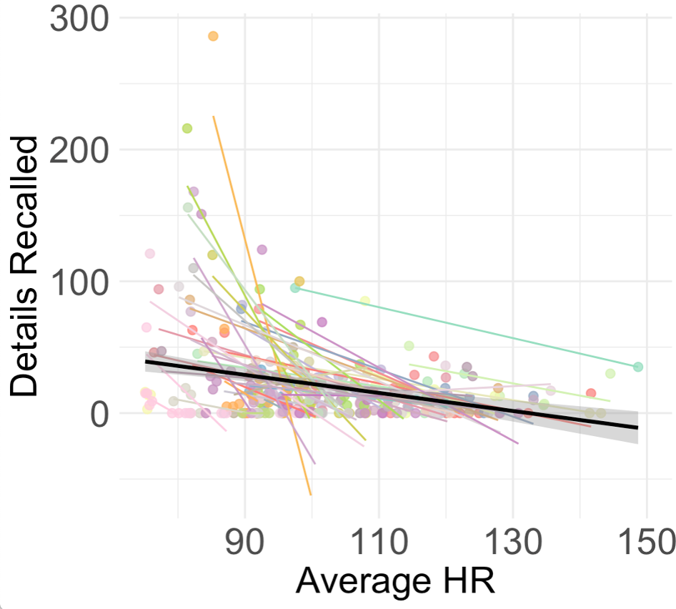

As arousal during encoding increases, later memories contain less details.
A mixed-effects model shows that average HR affects the overall amount of details reported across HH and lab (χ2(1)=32.257, p<.001), where increased arousal predicts a decrease in overall details recalled.

Slide 57

As arousal during encoding incrases, later memories contain a higher proportion of perceptual details.
A mixed-effects model shows that average HR affects perceptual detail bias across HH and lab (χ2(1)=6.934, p<.01), where increased arousal predicts a higher proportion of perceptual details recalled.

Slide 58


Slide 59

Project Introduction
Rationale
Methods
Measures
How does emotional and physiological arousal inform perceptions?
How does arousal affect memory contiguity at recall?
When does emotion predict regulation?
How do emotion and arousal affect what you remember?

Slide 60
Dave Gregory
Count of Contiguity
Question:
How does arousal affect memory contiguity at recall?
Measures Used:
Free Recall Transcripts

Slide 61
Memory Contiguity
Our lives consist of a continuous series of subjective episodes that naturally unfold over time.
These episodes are often remembered as we originally experienced each event.
Memory contiguity, defined as high temporal clustering and proportional forward transition movement in memory, depends on context binding, which supports recall for events as experienced.
Yet, this type of recall is fallible, and open questions remain about which behavioral and neurological factors distort memory contiguity.
We propose that aversive, emotionally-charged experiences can disrupt the continuous flow of events and impair memory contiguity structure.

Slide 62

Temporal Context Model (TCM)
A prominent theoretical model of free recall suggests that events are bound to a temporal context during encoding (Howard & Kahana, 2001).
Temporal contexts are then reinstated during retrieval thus leading individuals to recall events (or items, i.e. ‘A’) in order observed.
Memory cohesion is supported by individual items becoming embedded within a slowly-drifting temporal context, a process which is mediated by the hippocampus.
Given this, disruptions within item-context binding should disrupt memory contiguity.

Slide 63

High Arousal States Disrupt Item-Context Binding
High arousal and noradrenergic tone may bias encoding towards item-based processing and away from contextual binding (Clewett & Murty, 2019).
Threat-related contexts divert information processing away from hippocampal associative binding (Murty & Adcock, 2017).

Slide 64

Hypothesis
Impaired Memory Contiguity
Intact Memory Contiguity in Recall

Slide 65


Analysis Approach for Memory Contiguity Studies
Section of script
Free recall was transcribed and broken up into meaningful clauses (following Levine et al., 2002).
Recalled events were identified and labeled, and non-distinct events were removed after scoring of scripts.
Section of scoring sheet

Slide 66

Analysis Approach
Terror Behind the Walls Schematic
Temporal Clustering
Conditional probability of making a near versus far recalled events in memory
Forward Transition
Proportion of events recalled backwards or forwards from last event in memory
NOTE: Memory recall of each event is limited to verifiable events from both haunted house and lab, meaning only fixtures or individuals who did not change position and appeared each night as well as specific aspects of lab procedures.

Slide 67





Temporal Clustering was Disrupted in the haunted house
*
Close
Probability of Clustering
Far
haunted house
lab
Individuals had significantly less temporal clustering in free recall of the haunted house versus the lab, suggesting less use of temporal context to guide memory recall (p<0.001).

Slide 68


Proportion of Forward Transition was lower in the haunted house
*
Forward
Proportion of Transitions
Backward
haunted house
lab
Individuals made significantly less forward transition in free recall of the haunted house versus the lab, suggesting less use of a sequential narrative to guide memory recall (p<0.001).

Slide 69


Summary
Memory contiguity was disrupted in a highly arousing environment leading to temporal context and sequential narrative disruptions.
Memory fallibility after threat may divert contextual binding towards item-based processing, which may reflect in less hippocampal associative binding.
Grrrrr!
Ahhhhh!

Slide 70
General future directions/collaborations
Which regulation strategies do people spontaneously use? In what circumstances are they used? Are they successful?
How may self-reported regulation and/or heart rate variability mediate discrepancies in recalled fear intensity?
How does regulation strategy modulate what details of an emotional experience are recalled?
Is there a relationship between under/over-estimated metacognitive beliefs about fear and later perceptual detail recall?
Can we find evidence of memory organization based on emotional state?
Does heart rate and fear ratings predict temporal contiguity disruptions?
What does fMRI data inform on arousal and memory structure?
Notes:
The lab literature on emotional regulation presents a lot of data suggesting that different strategies are better suited for different circumstances, and the EMA literature supports the notion that broader well-being is contingent upon reliably choosing the appropriate strategy for the appropriate situation. It’d be really interesting to see whether this is consistent with our data from the field and we’re in the process of those analyses right now.

Slide 71
Thanks to all our labs for help on this project!
15 nights at TBTW/50+ scans all in 1 month!
AML
Deepu Murty, PI
Emily Cowan
Elizabeth Eberts
Karen Shen
Matthew Fain (we miss you!)
Jane Rothrock
Devlin Eckardt
Kate Cliver
Kathryn Lockwood
Nicole Gonzalez
SAN
Chelsea Helion, PI
Adhya Gowda
Bijal Patel

Slide 72


